Slide 1


FINANCIAL SECURITY
AND INSURANCE
www.fempower.finance

Slide 2
IMPRINT & DISCLAIMER
This resource has been developed within the context of the Erasmus+ project “FEMpower in Finance: Upskilling women in sustainable financial literacy to raise their confidence and counter the threat of old age poverty.”
The information, explanations, calculations, examples, and any related materials provided through this resource are intended exclusively for educational and informational purposes. They are designed to support learning activities in financial literacy. They do not constitute financial, investment, legal, tax, accounting, or any other professional advice.
No Financial or Investment Advice
Nothing in the resources provided by the project should be interpreted as a recommendation to buy, sell, hold, or otherwise transact in any financial product, nor as guidance on any individual investment / financial strategy. Users should seek independent advice from qualified professionals before making financial decisions.
No guarantee of accuracy or suitability
While reasonable efforts have been made to ensure that our resources are coherent and usable, the project partners and authors provide them “as is” and make no representations or warranties (express or implied) regarding completeness, correctness, timeliness, fitness for a particular purpose, or outcomes achieved through their use. Financial results and projections may vary significantly depending on personal circumstances, assumptions, market developments, and user inputs.
User responsibility for inputs and outcomes in templates
Users are solely responsible for
the accuracy of all data they enter,
the assumptions they apply, and
any actions they take based on outputs generated by the resources provided. Any figures shown are indicative only and may be affected by rounding, methodology choices, or spreadsheet software settings.
Limitation of liability
To the fullest extent permitted by applicable law, the project partners, authors, and associated organisations shall not be liable for any direct or indirect loss or damage (including financial loss, lost profits, or consequential damages) arising from the use of, inability to use, or reliance on the resources of the project.
Third-party sources and links
Where resources reference external sources, tools, or links, these are provided for convenience and learning. The project partners do not control such third-party content and do not endorse or accept responsibility for it.
Erasmus+ context and responsibility statement.
This resource is produced for learning purposes in the framework of the FEMpower in Finance project. The views expressed in this template are those of the authors and do not necessarily reflect the official position of the European Union or any National Agency; neither the European Union nor the granting authority may be held responsible for any use made of the information contained herein.”
Content Developers
The FEMpower in Finance Project consortium
(2026-2022) is a joint project by
Tvw GmbH - Germany
UCLAN Cyprus Limited - Cyprus
Momentum Educate and Innovate - Ireland
The Hub Nicosia - Cyprus
Stichting Go Woman Alliance Europe – Netherlands
Publication date: May 2026

Slide 3

Financial Security and Insurance
01
Introduction 4
page
page
page
02
11
03
20
04
32
Women in Early Career
Women in Mid Career
Women in Late Career
05
Conclusion 42

Slide 4
01
INTRODUCTION
TO FINANCIAL SECURITY AND
INSURANCE

Slide 5
.
Introduction
Introduction
“Financial security isn’t about being rich—it’s about being ready.”
Financial security involves protecting yourself against life’s risks—from health emergencies to natural disasters and economic uncertainty. Insurance and proactive financial planning provide essential tools for women to create stability and peace of mind across all ages. To achieve these aims, this module uses simple financial terminology that can be easily understood by women of different ages and career stages, irrespective of their educational background.
Insurance is a financial tool designed to protect you from unexpected events that could otherwise cause significant financial hardship. Whether it's a car accident, illness, theft, or damage to your home, insurance helps you manage risk by sharing it with others.
This module helps you understand how insurance can protect you and your loved ones from unexpected financial shocks. Whether you're just starting your career, juggling family responsibilities, or preparing for retirement, insurance is a key part of your financial toolkit.
The goal is to help empower women through financial preparedness.
Learning Objectives
By the end of this module, you will be able to:
Identify your personal financial risks and how to plan for them to help achieve financial security.
Understand the main types of insurance and what they cover.
Read and understand basic insurance policies.
Know how to make a claim and where to get help if something goes wrong.
Why Insurance Matters
Financial Stability: Prevents large, unexpected expenses from derailing your finances.
Peace of Mind: Knowing you're protected reduces stress.
Legal Requirements: Some types of insurance (e.g., car insurance) are mandatory in the EU.
Support for Loved Ones: Life and health insurance can protect your family’s future.
Conclusion

Slide 6
Your Personal Situation
Insurance needs vary from person to person, depending on their individual circumstances. To ensure you purchase the appropriate insurance cover for you, at any given stage in life, you first need to consider your personal situation.
Your insurance needs are influenced by several factors, including:
1. Age
Your age plays a big role in what kind of insurance you might need.
Younger women may not need as much coverage, but life insurance can be important if you have children or someone who depends on your income.
Older women often focus more on planning for retirement and may need long-term care insurance to help with future health costs.
2. Health Status
Your health affects the kind of insurance that’s right for you.
If you have ongoing health issues, you might need a health insurance plan that covers more treatments.
If you’re at higher risk of illness or injury, disability insurance can help replace your income if you can’t work.
3. Family Situation
Your family responsibilities influence your insurance needs.
If you have children, a partner, or elderly parents who rely on you, life insurance can help support them if something happens to you.
Parents may also want extra coverage to help with childcare or education costs.
4. Occupation
Your job can affect the type of insurance you need.
If you work in a risky job like construction or emergency services, you may need more coverage for accidents or disability.
If your job is low-risk, you might focus more on health or home insurance.
5. Lifestyle
What you do in your free time matters too.
If you travel often or enjoy adventurous hobbies like skiing or scuba diving, travel insurance or accident coverage is a good idea.
If you own valuable items like art, jewellery, or collectables, you may need special insurance to protect them.
6. Financial Goals
Your financial plans help guide your insurance choices.
If you have a lot of assets, umbrella insurance can protect you from legal claims.
If you're saving for retirement, long-term care insurance can help cover future health expenses.
You need to consider your personal situation and how these factors impact you. Only then can you determine the type and amount of insurance cover that you need to protect you and your dependents against financial risk.
Then you need to identify which types of insurance are most relevant to your current lifestyle, responsibilities, and financial goals. Refer to the sections relevant to your life stage for more information specifically related to your needs.
It is also important to regularly review your insurance cover as your personal situation changes over time.
An insurance needs Checklist is a great exercise to assess your current needs. You can find one here

Slide 7
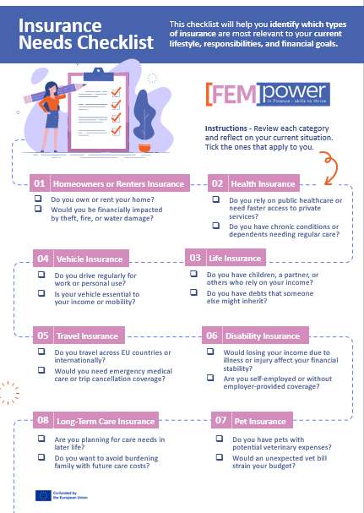

Slide 8
The Insurance You Need Now
Introduction
Once you have considered what your current insurance needs are, the next step is to identify the most appropriate insurance products for you at this time.
Trying to understand the details of insurance polices and distinguishing between them to find the best one for you can seem overwhelming. However, by working through the process in a logical and organised way, you can ensure you get the cover you need, at the price that is the best value for you.
You need to understand the limits of the insurance coverage you purchase and any exclusions that apply, so that the policy you choose is the one that best meets your needs.
Next, consider your income and existing financial commitments. This will help you plan how to include insurance premiums in your monthly budget without compromising savings or essentials. Use the Budgeting Worksheet provided to gain insights into your current expenditure and spending habits.
Once you have completed the activities below, we can move to the next section where we will consider the importance of carefully reading and understanding Insurance policies before committing to purchase. It is important that you only pay for what you need, but also get the cover you require.
Tips
Aim to keep insurance premiums within 5–10% of your income.
Consider bundling policies for discounts.
Review your budget annually or after major life changes..
Activities
Complete the insurance needs checklist to assess what are your current insurance needs
Complete the budgeting worksheet to understand your current financial situation and what funds you have available for insurance
Conclusion

Slide 9

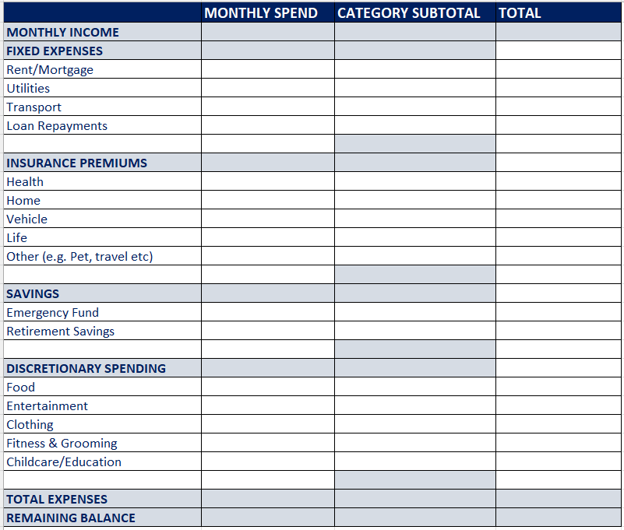
Budgeting Worksheet
Creating a budget worksheet is one of the most effective ways to take control of your finances. It helps you:
Understand where your money is going each month
Identify areas where you can save or adjust spending
Plan for future goals and avoid unnecessary debt
Reduce stress by having a clear financial roadmap
Instructions:
List your total monthly income.
Track your expenses
Compare income and expenses to see if you have a surplus or deficit
Adjust and set goals
Review regularly

Slide 10
Glossary
Introduction
Types of Insurance You Might Encounter
Health Insurance: Covers medical expenses.
Life Insurance: Provides financial support to your dependents if you pass away.
Property Insurance: Protects your property, residential or commercial, and your belongings.
Vehicle Insurance: Covers damage or liability related to your vehicle.
Travel Insurance: Covers unexpected events while travelling.
Income Protection: Supports you financially if you're unable to work due to illness or injury.
Renter Insurance: Protects tenants' personal belongings against loss due to theft, fire, or other covered events, and provides coverage for liability claims and additional living expenses.
Long-Term Care Insurance: Coverage that provides nursing-home care, home-health care, and personal or adult daycare
Burial Insurance: Is a type of life insurance specifically designed to cover unexpected final expenses or costs related to end-of-life care. These expenses might include funeral services, burial fees, medical bills or outstanding debts.
Key Concepts You Should Know
Premium: The amount you pay regularly (monthly, quarterly, or annually) to maintain your insurance coverage.
Policy: A contract between you and the insurance provider outlining what is covered, under what conditions, and for how much.
Deductible: The amount you must pay out-of-pocket before your insurance kicks in.
Claim: A request you make to your insurer to cover a loss or expense.
Coverage: The specific risks or events your insurance policy protects against
Coverage Limit: The maximum amount the insurer will pay.
Exclusions: What is not covered by the policy.
Co-pay/Co-insurance: Your share of the cost after the deductible is met.
Indemnity Value: The benefit amount is based on your actual income at the time of claim.
Agreed Value: The benefit amount is locked in when you take out the policy, based on proof of income at that time.
Conclusion

Slide 11
02
FINANCIAL SECURITY
AND INSURANCE FOR
WOMEN IN EARLY CAREER

Slide 12
Women in Early Career
Introduction
Learning Objectives:
Recognise financial risks faced by young women.
Start building financial safety nets.
Understand basic types of insurance (health, auto, rental).
Learn why emergency funds are essential.
Content:
Why you need an emergency fund even when young.
Health, renter, and travel insurance: what you need now.
Introduction to insurance terminology (premium, deductible).
How to assess whether an insurance policy is worthwhile.
Activities:
Insurance needs checklist.
Build a €2,500 emergency fund plan.
Vocabulary match-up: Insurance terms.
Formative Assessment:
Quiz: What type of insurance covers each situation?
Personal reflection: What risks worry me most?
Resources:
Glossary of financial terms
Beginner’s insurance guides
Sample insurance policies for review
Mobile apps for insurance comparison
Conclusion

Slide 13
Women in Early Career
Introduction
Recognise the Financial Risks Faced by Young Women
1. Gender Pay Gap
Young women typically earn less than men for similar roles, which limits their ability to save, invest, and build wealth over time. This gap is even wider for women in certain industries
2. Higher Exposure to Cost-of-Living Pressures
Young women are disproportionately affected by rising living costs. They often have smaller financial buffers, making them more vulnerable to debt and financial insecurity. Many report struggling to pay bills, relying on food banks, or taking on additional debt.
3. Limited Financial Inclusion
Between the ages of 15–24, the gender gap in financial inclusion widens. Young women are less likely to have bank accounts, access credit, or use digital financial tools, which restricts their ability to save and manage money effectively.
4. Career Interruptions and Lower Lifetime Earnings
Women often face career breaks for caregiving or maternity, reducing lifetime earnings and retirement savings. These interruptions also affect promotions and long-term financial security.
5. Lower Investment Participation
Young women tend to invest less aggressively and are less likely to enter the stock market compared to men, which can lead to smaller returns and slower wealth accumulation
6. Debt Burden
Student loans and credit card debt disproportionately affect young women, especially those from low-income backgrounds. High-interest debt can trap them in cycles of financial stress.
7. Housing Challenges
Young women spend a larger share of their income on housing and often struggle to move out of family homes, delaying independence and wealth-building opportunities like homeownership
Notes
Learn more here:
Young Women’s Trust Annual Survey
Financial Inclusion for Young Women
The Biggest Financial Hurdles Facing Young People Today
Conclusion

Slide 14
Women in Early Career
Introduction
Six Steps to Building a Financial Safety Net
1. Build an Emergency Fund
Start small: Aim for €1,000 as an initial buffer, then work toward 3–6 months of essential living expenses.
Keep it accessible but separate: Use a high-yield savings account for better returns while maintaining liquidity.
Automate savings: Set up automatic transfers to grow your fund consistently.
2. Get Adequate Insurance
Health insurance: Ensure coverage for your specific needs.
Disability insurance: Protects income if you can’t work—especially important for freelancers or sole earners.
Life insurance: Consider term life if others depend on your income..
Property insurance: Renters or homeowners coverage prevents financial disaster from unexpected events.
3. Manage Debt Wisely
Prioritise high-interest debt(like credit cards) first.
Make minimum payments on other debts while focusing extra funds on the most expensive ones.
Avoid accumulating new debt unless absolutely necessary.
4. Start Investing Early
Even small contributions to retirement accounts or index funds can grow significantly over time thanks to compounding.
Diversify investments to manage risk.
Consider low-cost options like ETFs or robo-advisors if you’re new to investing.
5. Protect Your Income and Career
Negotiate salary and benefits** to close the gender pay gap.
Invest in education and skill-building for long-term earning potential.
Build a strong professional network and seek mentorship opportunities.
6. Create a Financial Plan
Set clear short-term and long-term goals (e.g., emergency fund, home purchase, retirement).
Track expenses and maintain a realistic budget.
Schedule regular financial check-ins to adjust as life changes.
Tips
Start today
Calculate what you need for 3 – 6 months
Use a banking app to help you manage your money
Stay consistent and save every week
Refill your fund once you use any of it
Video
Watch this video to learn a simple money mapping process to help you take the first steps towards building your financial safety net.
.
Read
Financial independence is the key to true freedom and choice in every woman’s life. Women often face unique challenges in achieving financial autonomy, from wage gaps to career interruptions. Read why it is more important than ever for women to be financially independent.
Conclusion

Slide 15
Women in Early Career
Introduction
If you are starting your career this may be the first time you have had to consider purchasing insurance. With a wide range of options, it may seem daunting at first to choose the best options for you, so it is important to inform and educate yourself and make the decisions that best meet your needs.
Key Considerations
You may be starting your first job, renting a home or beginning to build savings. Perhaps you are repaying student debts.
You may not have dependents yet, but projecting your income is critical
You need to understand any employer benefits you are entitled to
Now is the time to start building an Emergency Fund.
Challenges
Limited income
Lack of financial literacy
Overlooked benefits at work
Insurance Priorities
Health Insurance: Ensure you’re covered either through your employer or a public scheme
.
Contents Insurance: Protect your belongings, especially if renting.
Income Protection: Consider coverage in case of illness or injury.
Travel Insurance: Ensure you upgrade to worldwide insurance for any trips outside Europe, and also upgrade to cover risky activities like skiing before you travel
Tips
Review your employment contract for insurance benefits.
Compare policies online using EU-wide comparison tools.
Start small—basic coverage is better than none.
Case Study
Emma, a 31-year-old graphic designer, recently moved to a new city to start her dream job.
With her newfound independence, she realised the importance of securing insurance to protect her health, belongings, and future.
Emma had little prior experience with insurance and felt overwhelmed by the options available.
Read how Emma found the right insurance for her in our interview LINK
Conclusion

Slide 16
Types of Insurance
Health Insurance
What It Is:
Health insurance helps cover the cost of medical care, including doctor visits, hospital stays, surgeries, prescriptions, and sometimes dental or mental health services.
How It Works:
You pay a monthly premium.
When you need medical care, the insurance covers part or all of the cost.
You may also pay a deductible (a set amount before coverage starts) and co-payments (a small fee per visit or service).
Most EU countries have public healthcare systems, but private health insurance can offer faster access, private hospitals, or coverage for services not included in the public system.
2. Home Insurance
What It Is:
Home insurance protects your home and belongings from damage, theft, or disasters like fire or flooding. It may also cover liability if someone is injured on your property.
How It Works:
You pay a monthly or annual premium.
If your home or belongings are damaged or stolen, you file a claim.
The insurer pays for repairs or replacements, up to your coverage limit.
Types:
Homeowners Insurance – for property owners.
Renters Insurance – for tenants, covering personal belongings and liability.
3. Vehicle Insurance
What It Is:
Vehicle insurance covers damage to your car, injuries from accidents, and liability if you cause harm to others or their property.
How It Works:
You pay a premium based on your car, driving history, and location.
If you're in an accident, the insurer pays for repairs, medical costs, or legal fees.
Third-party liability insurance is mandatory in all EU countries.
You can add comprehensive or collision coverage for more protection.
4. Life Insurance
What It Is:
Life insurance provides a financial payout to your chosen beneficiaries if you pass away. It helps cover funeral costs, debts, or ongoing living expenses for loved ones.
How It Works:
You pay a monthly or annual premium.
If you die during the policy term, your beneficiaries receive a lump sum.
Types:
Term Life Insurance – covers a set period (e.g., 20 years).
Whole Life Insurance – covers your entire life and may build cash value.

Slide 17
5. Travel Insurance
What It Is:
Travel insurance provides financial protection against unexpected events while travelling. It can cover medical emergencies, trip cancellations, lost luggage, and other travel-related issues.
How It Works:
You pay a one-time or annual premium depending on the policy.
If something goes wrong during your trip (e.g., illness, cancellation, theft), you file a claim.
The insurer reimburses you for covered expenses, up to the policy limit.
Types:
Single Trip Insurance – Covers one specific journey.
Annual Multi-Trip Insurance – Covers multiple trips within a year.
Specialist Travel Insurance – For high-risk activities (e.g., skiing, scuba diving) or pre-existing medical conditions.
6. Pet Insurance
What It Is:
Pet insurance helps cover veterinary costs if your pet becomes ill or injured. It can also include routine care, depending on the policy.
How It Works:
You pay a monthly or annual premium.
When your pet needs treatment, you pay the vet and submit a claim.
The insurer reimburses you for eligible expenses, minus any deductible.
7. Disability Insurance
What It Is:
Disability insurance provides income replacement if you’re unable to work due to illness or injury. It helps maintain financial stability during recovery.
How It Works:
You pay a monthly premium.
If you become disabled and can’t work, you receive regular payments (usually a percentage of your income).
Payments continue for a set period or until you recover.
Types:
Short-Term Disability Insurance – Covers temporary conditions (e.g., recovery from surgery).
Long-Term Disability Insurance – Covers extended or permanent disabilities.
Government-Provided Disability Benefits – Available in some EU countries, but may be limited.
8. Long-Term Care Insurance
What It Is:
Long-term care insurance helps cover the cost of care services if you become unable to perform daily activities due to age, illness, or disability. This includes home care, assisted living, or nursing home care.
How It Works:
You pay regular premiums, often starting in mid-life.
If you need long-term care, the policy pays for services up to a daily or monthly limit.
Coverage may begin after a waiting period and is subject to eligibility criteria.
Types:
Traditional Long-Term Care Insurance – Standalone policies with fixed benefits.
Hybrid Policies – Combine life insurance or annuities with long-term care benefits.
State-Supported Programs – Some EU countries offer public long-term care support, but private insurance can fill gaps.

Slide 18
Women in Early Career
Introduction
Build Your Emergency Fund
An emergency fund is a financial safety net designed to cover unexpected expenses—such as medical bills, car repairs, or job loss—without resorting to high-interest debt or liquidating long-term investments. Life’s unpredictability means emergencies often strike when least expected, and without a dedicated reserve, you may be forced to rely on credit cards or loans, which can derail your financial goals and add unnecessary stress. Having an emergency fund provides peace of mind and financial stability, allowing you to handle crises without compromising your future plans.
How to calculate the Emergency Fund you need
To calculate how much you should save, start by totalling your essential monthly expenses—including housing, utilities, groceries, insurance, and debt payments. Multiply this figure by the number of months you want to cover. Most financial experts recommend three to six months of living expenses as a baseline, but if your income is unstable or you have dependents, consider saving more (up to 12 months) for added security.
For example, if your monthly expenses are €2,500, a six-month emergency fund would be €15,000. This amount ensures you can maintain your lifestyle during unexpected disruptions without financial strain.
Tips
Use our Emergency Fund Calculator to help you determine how much you need in your personal Emergency Fund
LINK
Video
Watch this video and learn why an Emergency Fund is a Financial Safety net
Link to Video
Conclusion

Slide 19
Women in Early Career
Introduction
Check Your Knowledge
We have considered general information about Financial Security and Insurance, as well as factors that specifically impact you at your stage of life. Now it’s time to check what you have learned
Quiz
Take our Insurance Terms Vocabulary Quiz
Complete the FEMpower Insurance crossword puzzle
Reflection
Take a few moments to think about the topics addressed in this section.
What are three key things you have learned?
What are the risks that worry you most?
Write down the action you are going to take now that you have this new knowledge
Resources
MAPFRE España | Seguros
A Beginner’s Guide to Reading and Understanding Your Insurance Policy
Your Guide to Insurance Products in the EU
9 Real Life Situations Covered by Renters Insurance
European Insurance and Reinsurance Federation
Insurance Apps including: Techniker Krankenkasse (TK), Allianz Sigorta A.S. , MAPFRE Informatica
Conclusion

Slide 20
03
FINANCIAL SECURITY
AND INSURANCE FOR
WOMEN IN MID CAREER

Slide 21
Women in Mid Career
Introduction
Learning Objectives:
Assess gaps in current financial protections.
Learn about life, home, and income protection insurance.
Understand insurance in family planning and asset protection.
Compare policies and read the fine print.
Content:
Health coverage as family responsibilities grow.
When and why to consider life insurance.
Insurance for property, business, and vehicles.
Common pitfalls in policy terms—what to watch for.
Activities:
Analyse three insurance quotes for the same scenario.
Plan insurance coverage for a fictional household.
Create a checklist of what insurance you currently have.
Formative Assessment:
Short-answer: What risks are you underinsured against?
Mini-quiz: True or false about life and income protection.
Resources:
Glossary of financial terms
Governmental insurance literacy brochures
Policy comparison tools
Financial protection planning templates
Conclusion

Slide 22
Women in Mid Career
Introduction
If you are in midlife and the mid-stage of your career, you are probably juggling a lot of responsibilities, both at home and at work.
You must put in place the proper plans and insurance to be certain that you and your loved ones are properly protected.
Women in mid-career face a unique combination of pressures: they are more likely than men to have taken career breaks for caregiving, often earn less due to the gender pay gap, and frequently carry the 'mental load' of managing family finances alongside professional responsibilities. This means insurance and financial planning at this stage is not just about coverage, it is about compensating for structural gaps that have compounded over time."
Key considerations:
Your housing costs, rent or mortgage, are a significant expenditure each month, and your ability to pay must be secure
You may have caring responsibilities for children, older family members or pets and their needs must be factored into your plan.
With a lot of responsibilities, it is important that, as well as insuring your assets, you have adequate health and income protection insurance
As your circumstances change in mid-life, it is important to keep reviewing and updating your insurance cover.
Challenges
A lot of current spending demands on your income
Difficult to set aside funds for future needs and savings
Family and career demands and responsibilities are both at peak levels in midlife.
Insurance Priorities:
Health Insurance as family responsibilities grow
Life Insurance
Protecting your assets, including income and property
Tips
Do a complete audit of all your existing insurance policies
Identify if you have gaps in cover, or are overpaying for insurance cover you no longer need
Interview
Watch this series of videos from Life Happens to learn about real-life experiences and challenges, and how having the right insurance in place can help you overcome those challenges and ensure your financial security.
Life Happens Video Series
Conclusion

Slide 23
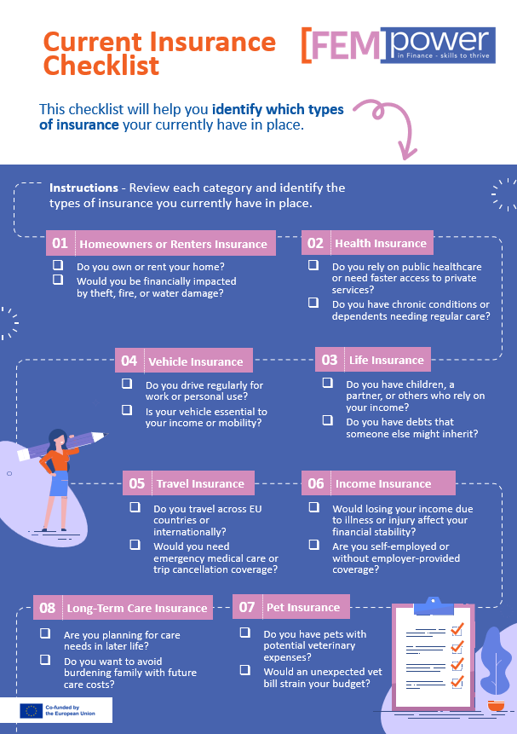
Activity

Slide 24
Women in Mid Career
The first thing to do is carry out a comprehensive review of all your existing insurance policies, to identify gaps and policies that need to be updated.
1: Gather All Current Policies
Collect documents for:
Health Insurance (public and private)
Life Insurance
Income Protection / Disability
Critical Illness Cover
Long-Term Care Insurance
Home and Auto Insurance (if relevant)
Note policy numbers, coverage limits, premiums, and renewal dates.
2: Define Your Current Life Stage Needs
Women in mid-life often face:
Health Risks: Menopause-related care, screenings (breast, cervical, osteoporosis).
Financial Responsibilities: Mortgage, children’s education, and ageing parents.
Retirement Planning: Ensuring coverage aligns with long-term goals.
Create a checklist of needs:
Preventive health care
Chronic illness management
Income replacement if unable to work
Family protection (life insurance)
Long-term care planning
Note for Women: Career breaks for maternity or elder care often create gaps in employer-provided coverage, pension contributions, and income protection. When reviewing your policies, flag any periods where you were not in full-time employment and check whether those gaps created underinsurance

Slide 25
Women in Mid Career
3: Review Each Policy Against Needs
For each policy:
Coverage Scope: Does it include preventive care, specialist visits, and mental health?
Limits & Exclusions: Are there caps on cancer treatment, fertility, or chronic conditions?
Waiting Periods: For pre-existing conditions or new benefits.
Beneficiaries: Are they up to date?
4: Identify Gaps
Common gaps for mid-life women:
Critical Illness Cover: Often missing or insufficient.
Menopause & Hormonal Care: Not always included in standard health plans.
Mental Health Support: Limited sessions or high co-pay.
Long-Term Care: Rarely covered unless specifically purchased.
Income Protection: Check if coverage lasts until retirement age.
5: Quantify Financial Risk
Estimate potential out-of-pocket costs for uncovered areas.
Compare against emergency savings and retirement funds.
6: Take Action
Upgrade Existing Policies: Add riders for critical illness or mental health.
Shop for Additional Coverage: Compare private health plans for preventive and specialist care.
Adjust Beneficiaries: Reflect current family situation.
Review Annually: Life stage changes (empty nest, retirement) require updates.

Slide 26
Women in Mid Career
5 Common Pitfalls in Insurance Policies You Should Particularly Look Out For as a Woman
1. Exclusions and Limitations
Many policies exclude certain conditions (e.g., pre-existing illnesses, mental health issues, or high-risk activities).
Some treatments or events may not be covered at all—always check the exclusions section.
2. Misunderstanding “Income Protection”
It does not cover redundancy or job loss—only illness or injury preventing you from working.
Many people assume it covers unemployment, which is incorrect.
3. Waiting Periods
Health and income protection policies often have waiting periods before benefits start.
For income protection, this is called a deferred period (commonly 4–13 weeks).
4. Underinsurance
Choosing a lower coverage amount to save on premiums can leave you financially exposed.
For life insurance, ensure the sum insured covers debts, mortgage, and dependents’ needs
5. Beneficiary Designation
Not updating beneficiaries after major life events (marriage, divorce) can cause disputes.
Always review and update regularly.
And general Pitfalls you should also consider
Policy Lapse
Missing premium payments can cause your policy to lapse, leaving you without coverage.
Some insurers allow a grace period, but not all.
Non-Disclosure
Failing to disclose medical history or lifestyle factors (e.g., smoking) can void your policy.
Always answer application questions honestly.
Indexation Clauses
If your policy isn’t indexed to inflation, the payout may lose value over time.
Check if your policy offers automatic inflation protection.
Renewal Terms
Some policies are guaranteed renewable; others may require reassessment at renewal.
Premiums can increase significantly as you age.
Optional Riders
Riders (e.g., critical illness, waiver of premium) add value but also cost.
Understand what’s included and whether you need them.

Slide 27
Women in Mid Career
Introduction
Health Insurance as Family Responsibilities Grow
In the EU, insurers cannot calculate premiums based on gender. This means women cannot be charged more or less than men for the same coverage, even though women typically have longer life expectancy and different health risks. In the EU, citizens are entitled to cross-border healthcare rights. Women can access medically necessary care in other EU countries under the European Health Insurance Card (EHIC), but this does not replace private insurance for elective or comprehensive coverage.
What does Private Health Insurance Cover?
For women in midlife, private health insurance typically covers:
Preventive Care: Screenings for breast cancer, cervical cancer, and osteoporosis.
Chronic Disease Management: Diabetes, cardiovascular conditions, and menopause-related care.
Mental Health Services: Increasingly included post-COVID reforms.
Maternity & Reproductive Health: Coverage for late pregnancies or fertility treatments varies widely.
Differences from Country to Country
1. Germany (Bismarck Model)
Private insurance supplements statutory coverage.
Comprehensive plans often include advanced screenings and private hospital rooms.
Premiums based on age and health status, not gender.
Waiting periods for pre-existing conditions may apply.
2. France
Public system covers most essential care, but private insurance is common for faster access and better amenities.
Women in midlife often choose “Mutuelle” plans for dental, vision, and specialist care.
Fertility treatments are partially covered by the public system until age 43; private plans may extend coverage.
3. Ireland
Public healthcare is free for low-income residents, but long waiting times make private insurance almost essential.
Private plans often include cancer screenings and menopause support.
Premiums regulated; no gender-based pricing.
4. Nordic Countries (e.g. Sweden, Denmark)
Strong public systems; private insurance mainly for faster access.
Preventive care and screenings widely available through public system.
Private plans are rarely needed unless for elective procedures or comfort upgrades.
5. Eastern Europe (e.g. Poland, Bulgaria)
Public systems are less comprehensive; private insurance is more critical for quality care.
Coverage for chronic conditions and advanced diagnostics is often limited in public schemes.
Private plans vary widely in cost and scope.
Notes
Conclusion
Links to resources on Health Insurance:
General EU-wide guide
Guide to specific countries
Germany France Ireland

Slide 28
Women in Mid Career
Introduction
Which Other Insurances Should You Prioritise?
Life Insurance
What It Is:
Life insurance provides a financial payout to your chosen beneficiaries if you pass away. It helps cover funeral costs, debts, or ongoing living expenses for loved ones.
How It Works:
You pay a monthly or annual premium.
If you die during the policy term, your beneficiaries receive a lump sum.
Types:
Term Life Insurance – covers a set period (e.g., 20 years).
Whole Life Insurance – covers your entire life and may build cash value.
Income Insurance
What it is:
Income insurance is designed to protect your most valuable asset—your ability to earn an income. If you become unable to work due to health-related issues, this insurance can replace a significant portion of your lost earnings, helping you maintain your lifestyle and meet financial obligations during challenging times.
How it works:
You pay a monthly or annual premium
Some policies only cover severe and permanent disability, while others are more flexible
Complete a claim form then wait for assessment
If approved, benefits are usually paid monthly
Your insurer will conduct regular reviews to monitor your condition
Home Insurance
What It Is:
Home insurance protects your home and belongings from damage, theft, or disasters like fire or flooding. It may also cover liability if someone is injured on your property.
How It Works:
You pay a monthly or annual premium.
If your home or belongings are damaged or stolen, you file a claim.
The insurer pays for repairs or replacements, up to your coverage limit.
Tips
Bundle Policies: Combining home, auto, and business insurance often saves money.
Review Regularly: Reassess coverage every 2–3 years or after major life changes.
Emergency Fund: Insurance reduces risk, but cash reserves provide flexibility.
Activity
Download The Life and Income Insurance Quiz
Activity
Download Home Insurance comparison activity.
Conclusion

Slide 29
Women in Mid Career
When Should a Woman in Midlife Buy Life Insurance?
Major Life Changes: Marriage, divorce, starting or expanding a family, buying a home, or taking on significant debt are key triggers for coverage.
Peak Financial Responsibility Years: Your 40s and 50s often coincide with:
  - Mortgage obligations
  - Children’s education costs
  - Supporting ageing parents
Before Health Risks Increase: Premiums rise sharply after 45–50, and health issues can limit options. Locking in coverage earlier ensures affordability and insurability.
Employment Transitions: If you rely on employer-provided life insurance, consider a personal policy before changing jobs or retiring, as workplace coverage often ends when employment does.
Retirement Planning: In your 50s, permanent life insurance can help with estate planning, wealth transfer, and covering final expenses.
Why Is Life Insurance Important for Women in Midlife?
1. Income Replacement
Nearly 40% of women are primary breadwinners, and most households depend on two incomes. Losing one income can destabilise family finances.
2. Covering Debts & Obligations
Mortgages, loans, and credit card debt don’t disappear after death. Life insurance prevents loved ones from inheriting financial burdens.
3. Child & Family Security
Funds for children’s education, daily living expenses, and future caregiving needs ensure stability if you’re no longer there.
4. Valuing Non-Income Contributions
Stay-at-home mothers or caregivers provide services worth over €180,000 annually. Life insurance helps cover childcare and household management costs if they pass away.
5. Estate & Retirement Planning
Permanent policies can build cash value, assist with retirement income, and cover estate taxes or charitable legacies.
6. Peace of Mind
Knowing your family won’t face financial hardship provides emotional security during an unpredictable stage of life.
Best Policy Types for Midlife Women
Term Life Insurance: Affordable, ideal for covering obligations like mortgages and college costs for 10–30 years.
Permanent Life Insurance: Whole or universal life for lifelong coverage, estate planning, and cash value accumulation.
Hybrid Policies: Combine life insurance with long-term care benefits for future health needs.

Slide 30
Women in Mid Career
Introduction
What You Should Know About Income Insurance
Women are statistically more likely to experience interrupted income due to maternity leave, part-time work during caregiving years, or career pivots. This makes income protection insurance one of the most important, and most overlooked, financial tools for women in mid-career."
1. Understand Why It Matters
Women often face unique financial challenges: longer life expectancy, potential career breaks, and caregiving responsibilities. Income protection ensures financial stability if illness or injury prevents you from working.
2. Calculate Adequate Coverage
Most policies replace 50–70% of your pre-tax income.
Consider essential expenses: mortgage/rent, utilities, childcare, and debt repayments.
Factor in long-term goals like retirement savings and education costs.
3. Check Waiting Period & Benefit Period
Waiting Period: Time before benefits start (commonly 30–90 days). Shorter periods cost more but provide quicker support.
Benefit Period: How long payments last (e.g., 2 years, 5 years, or until retirement). Longer periods offer better security but higher premiums
4. Review Policy Definitions & Exclusions
Understand what counts as disability or illness.
Check exclusions for pre-existing conditions or certain injuries.
Ensure the policy covers your specific occupation, especially if you have specialised skills.
5. Consider Inflation Protection
Without indexation, benefits lose value over time. Choose a policy that adjusts payouts for inflation
6. Choose the Right Policy Type
Indemnity Value: Cheaper, but payout depends on income at claim time.
Agreed Value: More expensive, but guarantees a fixed benefit regardless of income changes.
7. Factor in Age, Health & Occupation
Premiums rise sharply after 45–50. Lock in coverage early.
Health conditions and high-risk jobs increase costs. Maintaining a healthy lifestyle can lower premiums.
Conclusion

Slide 31
Women in Mid Career
Introduction
Home Insurance
Key Considerations:
Coverage Scope: Ensure protection for structure, contents, and liability. Check if the policy includes additional living expenses if the home becomes uninhabitable.
Policy Limits & Deductibles Confirm coverage equals full rebuild cost, not just market value. Higher deductibles lower premiums but increase out-of-pocket risk.
Exclusions & Add-ons: Floods, earthquakes, and certain natural disasters may require separate coverage. Consider riders for valuable items (jewellery, art).
Insurer Reputation & Discounts: Choose financially stable insurers with strong claims service. Ask about multi-policy discounts or savings for security upgrades.
Lifestyle Factors: Downsizing or relocating? Test the area before buying (e.g., rent for 6 months). Avoid emotional decisions—plan and research market trends.
Reflection
What coverage gaps do you have because of time spent outside the workforce?
Resources
Find a selection of Insurance literacy resources here
Insurance Europe
European Insurance and Occupational Pensions Authority (EIOPA)
Financial Literacy in Europe
Activity
Take a few moments and consider What risks are you underinsured for?
Conclusion

Slide 32
04
FINANCIAL SECURITY
AND INSURANCE FOR
WOMEN IN LATE CAREER

Slide 33
Women in Late Career
Introduction
Learning Objectives:
Reassess insurance needs after retirement or reduced income.
Prepare for health-related financial risks.
Understand long-term care and burial insurance.
Identify and avoid insurance fraud targeting seniors.
Content:
Do you still need life insurance?
Reviewing private vs. public health coverage.
Planning for long-term care: options and costs.
Recognising red flags in insurance marketing to seniors.
Activities:
Case study: An elderly woman reviewing her coverage.
Peer-sharing: What insurance did you keep? Drop?
Read and critique a sample long-term care policy.
Formative Assessment:
Quiz: Do you know what your insurance covers?
Prompt: What financial risk do you feel least prepared for?
Resources:
Glossary of financial terms
Long-term care information sites
Senior fraud prevention toolkits
Retirement risk calculators
Conclusion

Slide 34
Women in Late Career
Introduction
Women approaching retirement face a particularly acute financial challenge: decades of lower average earnings, pension gaps caused by career breaks, and longer life expectancy mean that the same retirement savings must stretch further for women than for men. This section helps you assess where you stand and take targeted action."
Key Considerations
Healthcare and Long-Term Care Costs
Women face higher healthcare expenses in retirement, including potential long-term care needs. Planning for these costs is critical.
Investment Strategy and Risk Tolerance
Many women lean toward conservative investments, which can limit growth. A balanced approach that accounts for longevity and inflation is essential.
Estate and Legacy Planning
Consider wills, trusts, and beneficiary designations to protect assets and ensure wealth transfer aligns with personal goals
Challenges
Outliving Savings
Lower Lifetime Earnings
Caregiving Responsibilities
Inflation and Rising Costs
Priorities
Maximise Retirement Contributions
Create a Longevity-Focused Plan
Build an Emergency Fund
Ensure you are registered for and claiming all benefits you are entitled to
Review Insurance and Estate Plans
Video
Watch to discover why women are more likely to live in poverty when they retire
Read
Discover why women have a different retirement experience than men
Case Study
In this Case Study, 54-year-old Margaret takes stock of her current situation, considers what additional cover she needs and identifies duplications where she is excessively covered.
Conclusion

Slide 35
Women in Late Career
Conduct an annual insurance review to ensure your cover aligns with health, income and lifestyle changes. It is important not to over-insure, so drop any policies that no longer serve a purpose, e.g. excessive life cover. Ill-health and long-term care costs are the biggest threats to retirement security, so make sure you have adequate cover in place.
1. Assess Your Pension Situation
Check your state pension forecast using your country’s online pension tracking system (available in most EU states).
Understand retirement age rules and contribution requirements in your country (e.g., 40 years of contributions for full pension in many EU states).
Identify any gaps due to career breaks or part-time work and consider voluntary contributions or private pension plans.
2. Supplement with Private Savings
Explore occupational pensions (e.g., employer schemes) and personal pension products (Riester, Rürup, or similar EU equivalents).
Use catch-up contributions if available for those over 50.
Diversify investments to balance growth and risk, considering longevity and inflation.
3. Plan for Longevity
Women in the EU live 5+ years longer than men, so plan for 20–30 years of retirement income.
Model different spending phases (active years vs. later years with higher healthcare costs).
4. Healthcare & Long-Term Care
Verify public healthcare coverage and consider private health insurance for gaps (especially dental, vision, or long-term care).
Budget for long-term care, as women are more likely to need it.
5. Emergency & Liquidity
Maintain an emergency fund covering 3–6 months of expenses for unexpected events.
Keep some assets liquid for unforeseen healthcare or family needs.
6. Tax & Cross-Border Issues
If you worked in multiple EU countries, check pension portability rules under EU coordination. See Understanding EU actions on pensions, below
Review tax implications for pensions and investments in your country.
7. Estate & Family Planning
Update wills, powers of attorney, and beneficiary designations.
Consider inheritance laws in your country (many EU states have forced heirship rules).
8. Financial Independence
Avoid delegating financial decisions entirely to a partner; ensure you understand your own assets and rights.
Seek professional advice for tailored strategies and confidence-building.
Resources
EIOP Planning for retirement video
The Retirement Systems in the European Union
Understanding EU Actions on pensions
Financial Security for Women in Retirement in Germany

Slide 36
Women in Late Career
Introduction
Conduct a Needs Analysis to determine if you still need Life Insurance.
Key Questions to Ask Yourself
Do I have debts or dependents who need protection?
Would my spouse lose pension income if I die?
Do I want to leave an inheritance or cover estate taxes?
Can my savings handle funeral and final expenses?
Is the premium cost justified by the benefit?
1. Current Financial Situation
If you still have a mortgage, personal loans, or other liabilities, life insurance can prevent these from burdening your heirs.
If there are family members (spouse, children, others) who rely on your income or pension, they would face financial hardship without you; coverage may still be needed.
If your pension, savings, and investments are sufficient to cover living costs and final expenses, your need for life insurance decreases
2. Review Existing Policies
Premiums rise with age. If the policy is expensive and your financial obligations are minimal, consider reducing or cancelling coverage.
Type of Policy:
Term Life: Often expires before or during retirement; may not be worth renewing unless you have short-term obligations.
Whole Life / Universal Life: Includes cash value; check tax implications before surrendering.
3. Define Your Goals for the Policy
Income Replacement: If you or your spouse depends on your earnings or pension, insurance can replace that income.
Estate Planning: Life insurance can provide liquidity for taxes or inheritance planning, especially if you own property in multiple EU countries.
Legacy or Charitable Giving: Some keep policies to leave a financial gift or donation.
Final Expenses: A small policy can cover funeral and medical costs, avoiding stress for loved ones.
Tips
Try our Life Insurance Assessment Checklist LINK
If most boxes are unchecked, you may no longer need life insurance. If several are checked, maintaining or adjusting coverage could be wise.
Resources
Life Insurance in Retirement: Do You Still Need It?
Retiring abroad - Your Europe
The Growing Protection Gap in European Insurance | BCG
Conclusion

Slide 37
Women in Late Career
Recognising Red Flags In Insurance Marketing To Seniors.
Common Red Flags in Insurance Offers
1. Unsolicited Contact
Calls, emails, or texts claiming to be from Medicare, Social Welfare, or an unknown insurer.
Legitimate agencies rarely initiate contact without prior consent.
2. Pressure to Act Immediately
Phrases like “Sign up today or lose coverage” or “Limited-time offer”.
Real insurers allow time for review and comparison.
3. Requests for Sensitive Information
Government ID number, bank details etc over phone/email.
Official entities never ask for these details unsolicited
4. Promises of “Free” or Unrealistic Benefits
Offers of free coverage, cash rewards, or benefits that sound too good to be true.
These often hide high fees or poor coverage.
5. Vague or Unprofessional Communication
Poor grammar, missing logos, generic email addresses (e.g., info@gmail.com).
6. Door-to-Door or High-Pressure Sales
Aggressive tactics or refusal to provide written details.
Always verify credentials via official registers
How to Protect Yourself
Verify the Source: Call your insurer or Welfare office using official numbers.
Never Sign Under Pressure: Take time to review with a trusted advisor.
Check Licensing: Use national registers for insurance intermediaries.
Keep Personal Data Private: Share only with verified providers.
Report Suspicious Activity: Contact local consumer protection agencies or Police.
Resources
2025cybersecurityolderadulttoolkitupdated_en.pdf
2025cybersecurityolderadulttoolkitupdated_en.pdf
How to Protect Seniors From Scams: Tips to Remember - Sen... | SeniorThrive

Slide 38
Women in Late Career
Introduction
Review the merits of Private vs Public Health Cover
Public Health Insurance is funded by taxpayers, and covers essential services, but may involve long waiting lists and limited choice of providers. Private Health Insurance can offer faster access and a wider choice of providers, but commands higher premiums or may demand age-related surcharges. Why does this matter particularly for women? Women over 60 are more likely to live alone, are more frequent users of healthcare, and are more likely to face long-term care costs.
1. Assess Your Personal Situation
Residency & Eligibility: Confirm if you qualify for full public coverage in your country (e.g., Ireland offers free public care for residents, but specialist wait times can exceed 18 weeks.
Health Status: Do you have chronic conditions or anticipate elective procedures? Private insurance often provides quicker access and broader coverage for these.
Income & Budget: Public systems are cost-effective; private premiums can rise significantly with age.
Lifestyle & Preferences: Do you value speed, comfort, and choice of English-speaking doctors? Private plans excel here.
2. Financial Planning Considerations
Budget for Rising Healthcare Costs: EU healthcare costs are increasing by ~3–4% annually; private premiums may rise faster. [mckinsey.com]
Longevity Risk
Women live longer on average; ensure coverage for 20–30 years post-retirement.
Hybrid Approach
Many retirees keep public coverage and add a supplemental private plan for faster access and elective care.
3. Create an Action Plan
Review Current Coverage: Check your public entitlements and any employer-provided benefits. Use our
Get Quotes: Compare private plans for late-career individuals; look for guaranteed renewability and coverage for chronic conditions.
Evaluate Cost vs. Benefit: Use a 10–15 year projection to see if private premiums fit your retirement budget.
Consider EU Mobility: If you plan to travel or live in multiple EU countries, ensure portability (EHIC + private international coverage). [nationalin…eguide.com]
Consult a Financial Advisor: Integrate health insurance decisions with pension, tax, and estate planning.
Notes
Navigating Private and Public Healthcare in Europe Today
Medical Insurance in the EU - National Insurance Guide
Link to FEMPOWER Health Insurance Comparison Checklist
Conclusion

Slide 39
Women in Late Career
Introduction
Planning for Long-term Care: Options and Costs
What Is Long-Term Care?
LTC includes support for daily living activities (bathing, dressing, eating) and sometimes medical care for chronic conditions. Services can be:
Home Care: Assistance at home with personal and household tasks.
Community-Based Care: Day centres or respite care.
Residential Care: Nursing homes or assisted living facilities.
Hybrid Models: Assisted living with access to medical support.
Why It Is Important for Women
By age 80, women are twice as likely as men to need long-term care due to longer life expectancy and higher rates of chronic illness.
EU projections show LTC demand will rise by over 30% by 2050, and costs are increasing faster than inflation
Common Options in the EU
Publicly Funded Care: Most EU countries offer partial coverage, but eligibility varies.
Private Care Services: Paid out-of-pocket or via private insurance.
Informal Care: Often provided by family, but this is declining due to social changes.
LTC Insurance: Mandatory in some countries (e.g., Germany), optional in others.
How Much Does It Cost?
Average Out-of-Pocket Costs: Can consume up to 70% of an older person’s median income, even after public benefits.
Severe Care Needs: Costs may reach 200–250% of median income without adequate coverage.
Tips
Start Early: Consider LTC insurance or savings plans before age 60.
Check National Schemes: Each EU country has different benefits—verify eligibility.
Diversify Funding: Combine public benefits, private insurance, and personal savings.
Preventive Health: Investing in healthy ageing reduces future care needs.
Plan for Inflation: LTC costs rise faster than general prices
Consider Your Own Care: If you have spent years as an informal carer for a parent or partner, remember that your own care needs in later life may be unfunded. Factor this into your long-term care plan
Resources
Is Care Affordable for Older People? | OECD
EUROSHIP-Working-paper-6-Long-term-care-regimes-in-Europe.pdf
Long-term care needs in the EU on the rise, due to demographic change - The Joint Research Centre: EU Science Hub
What is long-term care insurance? Pflegeversicherung explained | Feather
Conclusion

Slide 40
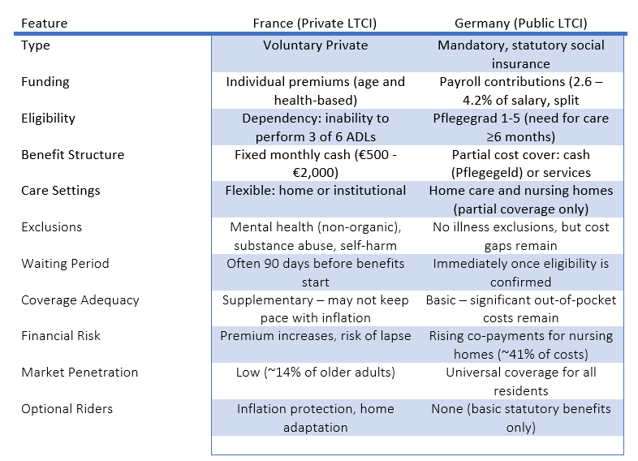
Women in Late Career
Lets compare France’s private LTC insurance model with Germany’s public LTC system (Pflegeversicherung)
Key Insights
France: Private LTCI offers flexibility but is optional, so many remain uninsured. Inflation protection is crucial.
Germany: Public LTCI guarantees basic coverage but does not eliminate financial risk—private supplemental LTC insurance is common.
Quiz
Reflection
Link to downloadable Life and Income Insurance quiz
Take a few moments to reflect on what financial risk you feel least prepared for, and has caregiving or a career break contributed to that gap?
What steps can you take to minimise that risk and become more financially secure?

Slide 41
Women in Late Career
Introduction
Create your 10 Year Roadmap, aiming for lifelong financial security.
Years 1–2: Assess & Optimise
Comprehensive Financial Review: Inventory assets, liabilities, pensions, and savings.
Maximise Contributions: Use catch-up provisions for retirement accounts
Debt Reduction: Pay off high-interest debt and consider downsizing if housing costs are high.
Insurance Check: Review health, life, and long-term care coverage.
Years 3–4: Strengthen Foundation
Emergency Fund: Ensure 6–12 months of expenses are set aside.
Investment Strategy: Shift toward a balanced portfolio (growth + income) to hedge inflation.
State Pension Planning: Model scenarios for claiming at 62, 67, or 70.
Years 5–6: Transition Planning
Retirement Lifestyle Budget: Estimate expenses for active vs. later years.
Healthcare Strategy: Explore supplemental insurance and long-term care options.
Tax Efficiency: Consider strategies to reduce future tax burden.
Years 7–8: Pre-Retirement Adjustments
Finalise Retirement Date: Align savings and income streams.
Estate Planning: Update wills, trusts, and beneficiary designations.
Risk Management: Reduce exposure to market volatility as retirement nears.
Years 9–10: Retirement Launch
Withdrawal Strategy: Implement a sustainable drawdown plan (e.g., 4% rule adjusted for longevity).
Monitor & Adjust: Review annually for inflation, market changes, and health needs.
Legacy Goals: Ensure charitable giving or inheritance plans are documented.
Notes
Use and Retirement Calculator to help you create the roadmap that works best for you.
Retirement Calculator Guide: Plan Your EU Pension & Financial Future
Retirement Calculator
ETF Savings Plan Calculator | justETF
Conclusion

Slide 42
05
CONCLUSION

Slide 43
Conclusion
Introduction
Financial security involves protecting yourself against life’s risks. As we go through life, those risks or the level of risk can change. Whatever stage of life you are it is important to regularly review your particular circumstances or situation, assess the risks you are most exposed to and take steps to make sure you are protected from those risks as much as possible.
Early career
It is never too early to start planning for the future. Even though your income might be small, starting pension payments now will yield huge rewards in later years.
Prioritise having an emergency fund
Regular saving, or investment, at this point in life, sets up good habits that will contribute to your long-term financial security.
Mid Career
This stage of life is often characterised by the increased burden of responsibility. Family responsibilities, Career progression leading to increased responsibilities and the financial burden that can come from caring responsibilities are often peaking at this time.
Life insurance, Health Insurance and Income Insurance become priorities as you need to ensure that the well-being of you and those you care for is secure
Late Career
At this point you should have an eye to your future retirement, making sure that you have planned correctly to provide an adequate standard of living for your later years, and making any adjustments needed to make sure that is the case.
It is also the time to focus on health insurance and long-term care insurance, again to make sure that you are adequately prepared for any future health issues and for your care in later years.
By committing to ongoing review and analysis of your current financial situation, and anticipating and preparing for future needs as well as unforeseen events women can plan for and ensure their financial independence and security.
Financial security isn't just about having money—it's about protecting what you have. With the right insurance and safeguards, women can face life's uncertainties with strength and confidence.
“Financial security isn’t about being rich—it’s about being ready.”
Conclusion

Slide 44
Resources
Introduction
Strategic Financial Planning for Women: The Ultimate Guide to Financial Confidence (+Interactive Toolkit) - womensoutfront.com
Glossary of Financial Terms: Demystifying the Complex Lingo!
Conclusion

Slide 45


Website Here
Follow Our Journey
www.fempower.finance

