Slide 1


RETIREMENT PLANNING
www.fempower.finance

Slide 2
IMPRINT & DISCLAIMER
This resource has been developed within the context of the Erasmus+ project “FEMpower in Finance: Upskilling women in sustainable financial literacy to raise their confidence and counter the threat of old age poverty.”
The information, explanations, calculations, examples, and any related materials provided through this resource are intended exclusively for educational and informational purposes. They are designed to support learning activities in financial literacy. They do not constitute financial, investment, legal, tax, accounting, or any other professional advice.
No Financial or Investment Advice
Nothing in the resources provided by the project should be interpreted as a recommendation to buy, sell, hold, or otherwise transact in any financial product, nor as guidance on any individual investment / financial strategy. Users should seek independent advice from qualified professionals before making financial decisions.
No guarantee of accuracy or suitability
While reasonable efforts have been made to ensure that our resources are coherent and usable, the project partners and authors provide them “as is” and make no representations or warranties (express or implied) regarding completeness, correctness, timeliness, fitness for a particular purpose, or outcomes achieved through their use. Financial results and projections may vary significantly depending on personal circumstances, assumptions, market developments, and user inputs.
User responsibility for inputs and outcomes in templates
Users are solely responsible for
the accuracy of all data they enter,
the assumptions they apply, and
any actions they take based on outputs generated by the resources provided. Any figures shown are indicative only and may be affected by rounding, methodology choices, or spreadsheet software settings.
Limitation of liability
To the fullest extent permitted by applicable law, the project partners, authors, and associated organisations shall not be liable for any direct or indirect loss or damage (including financial loss, lost profits, or consequential damages) arising from the use of, inability to use, or reliance on the resources of the project.
Third-party sources and links
Where resources reference external sources, tools, or links, these are provided for convenience and learning. The project partners do not control such third-party content and do not endorse or accept responsibility for it.
Erasmus+ context and responsibility statement.
This resource is produced for learning purposes in the framework of the FEMpower in Finance project. The views expressed in this template are those of the authors and do not necessarily reflect the official position of the European Union or any National Agency; neither the European Union nor the granting authority may be held responsible for any use made of the information contained herein.”
Content Developers
The FEMpower in Finance Project consortium
(2026-2022) is a joint project by
Tvw GmbH - Germany
UCLAN Cyprus Limited - Cyprus
Momentum Educate and Innovate - Ireland
The Hub Nicosia - Cyprus
Stichting Go Woman Alliance Europe – Netherlands
Publication date: May 2026

Slide 3

01
Introduction 4
page
page
page
02
11
03
16
04
26
Women in Early Career
Women in Mid Career
Women in Late Career
05
Conclusion 33

Slide 4
01
INTRODUCTION

Slide 5
Introduction
Introduction
“ The best time to start saving for retirement is yesterday. The second-best time is today”
Retirement is the stage in life when you stop working full-time and begin relying on savings, investments, and other income sources to support your lifestyle. It’s not just about leaving a job—it’s about planning for financial security so you can maintain independence and enjoy the years ahead. For women, retirement planning often requires extra attention because women tend to live longer than men, which means their savings need to last longer. Additionally, women may face challenges like career breaks for caregiving or earning less over their lifetime, which can reduce pension and Social Welfare benefits. This makes it especially important to start saving early, understand investment options, and consider strategies such as contributing to retirement accounts, even during career gaps.
Retirement planning is a lifelong process that prepares individuals to maintain financial independence and a desired quality of life after they stop working. For women, this is especially critical, as they are statistically more likely to live longer and experience career interruptions that affect pension accumulation. This module aims to equip women of all ages with the tools, knowledge, and confidence to start, review, and optimise their retirement plans. To achieve the aims, the module uses simple financial terminology that could be comprehended by women of different ages and career stages, irrespective of their educational background.
This module is designed to help women in the EU plan for a secure and comfortable retirement. It addresses the unique challenges women face at different life stages and provides practical tools and resources to support their retirement planning journey. The module aims to empower women at different stages of their careers with the knowledge and tools they need to plan effectively for retirement. By addressing the unique challenges women face, we hope to help them achieve financial security and peace of mind in their retirement years.
Learning Objectives
By the end of this module, you will be able to:
Understand the concept of retirement and both public and private pension schemes.
Set financial goals related to retirement
Review existing pensions and savings, and adjust plans where gaps are identified
Prepare emotionally and financially for the retirement transition
Why retirement planning is particularly important for women:
Women generally live longer than men
The gender pay gap means women have lower lifetime earnings
Women are more likely to have career interruptions and caregiving responsibilities, which reduce earnings and retirement contributions
Women are more likely to live in poverty in retirement
Conclusion

Slide 6
Your Personal Situation
Your retirement plan is personal to you. It reflects your individual circumstances and future needs. To create an effective retirement plan for yourself, you must always consider your personal situation and how that changes throughout your lifetime.
Your retirement plans will be influenced by several factors, including:
1. Current Age and Desired Retirement Age
This determines how many years you have to save and how long your retirement might last.
2. Life Expectancy and Health Status
Women generally live longer, so planning for extended healthcare and living expenses is crucial.
3. Marital Status and Family Responsibilities
Being single, married, divorced, or widowed affects income sources, benefits, and caregiving roles.
4. Career Path and Income History
Past earnings, job interruptions for caregiving, and access to employer-sponsored retirement plans influence savings.
5. Existing Savings and Investments
Current retirement accounts, pensions, and other assets form the foundation of your plan.
6. Debt Levels
Outstanding mortgages, loans, or credit card debt can impact retirement readiness.
7. Expected Lifestyle in Retirement
Travel, hobbies, or downsizing plans will affect how much you need.
8. State-funded Pension Benefits
These depend on work history and marital status.
9. Healthcare and Long-Term Care Needs
Anticipated medical costs and insurance coverage are major factors.
Once you have considered your personal situation, you can then start to determine the type of retirement plan you need and how to create it. The first step is to work through this retirement planning checklist.

Slide 7
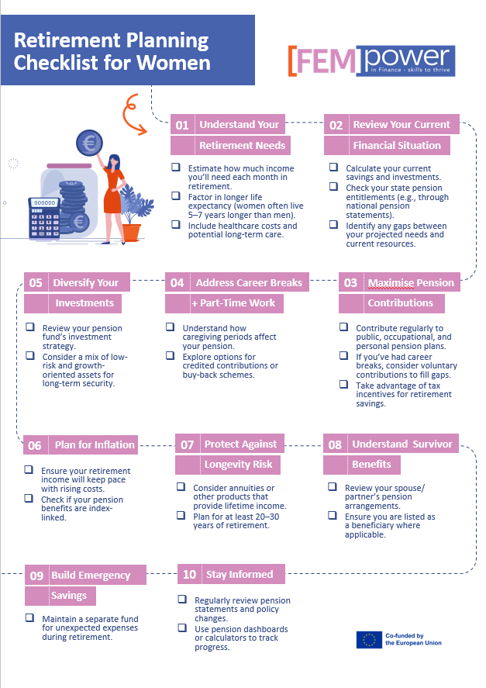
Retirement Planning Checklist
See accompanying Module 1 Resources for worksheet download

Slide 8
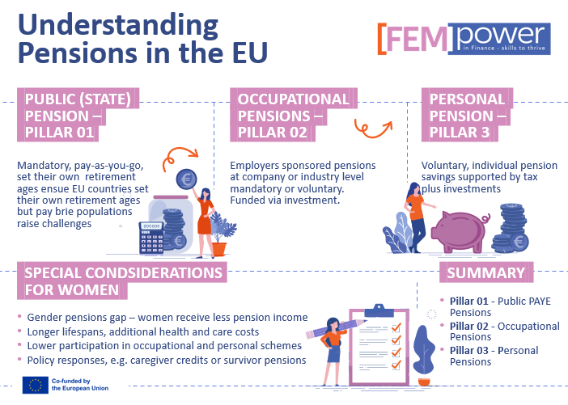
Overview of pension systems
EU pension systems are built on a three-pillar structure:
Public PAYG pensions (Pillar I) provide a universal basic income, funded by working-age contributions.
Occupational pensions (Pillar II) add employer- or sector-based, pre-funded retirement savings.
Personal pensions (Pillar III) offer voluntary savings with tax benefits.
While the EU plays a coordinating role, promoting sustainability, cross-border protections, and gender equality, implementation varies by country.
For women, planning must account for longer life expectancy, caregiving gaps, and earning disparities. Proactive saving, participating in employer schemes, and engaging with policy tools (such as care credits and dashboards) can help close the pension gender gap and ensure financial security in retirement.
Useful links
The retirement systems in the European Union
See accompanying Module 1 Resources for worksheet download

Slide 9
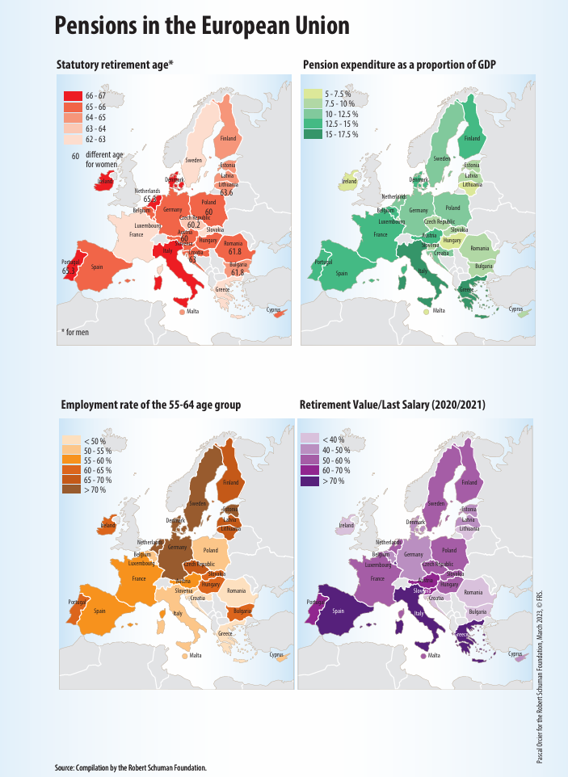
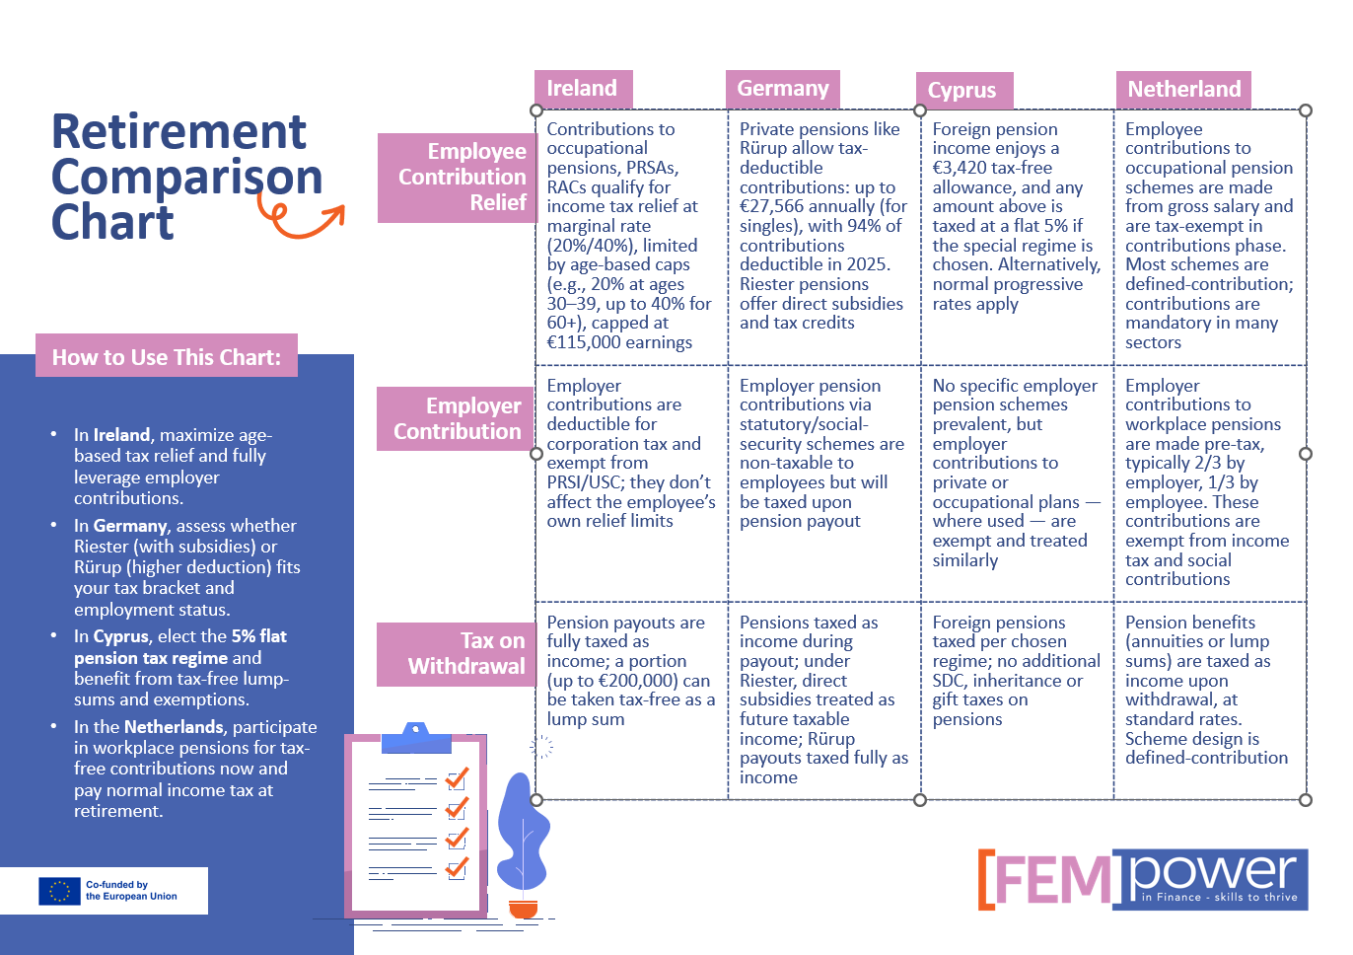
Overview of pension systems
The State Retirement support differs across Europe as you can see from the map, which is available to download from our accompanying Module 1 resource pack.
The comparison chart below outlines in a little more detail the differences in pensions between four countries.
This highlights the importance of understanding the benefits available to you, how to optimise pension contributions over your working life and the tax implications of both contributions and withdrawals, as these differ from country to country.

Slide 10
Glossary
Auto-Enrolment
A system where employees are automatically enrolled in a pension scheme but can opt out. This increases participation in supplementary pensions. [finance.ec.europa.eu]
Compound Interest
Interest earned not only on initial savings but also on the interest that accumulates over time.
Cross-Border Pension Rights
EU citizens can combine pension rights earned in different member states. Coordination rules ensure you don’t lose benefits when working across borders. [europa.eu]
Decumulation
The phase of retirement where you start withdrawing from your pension savings. Strategies vary for DB and DC schemes and affect long-term income security. [pensionseurope.eu]
Defined Benefit (DB) Scheme
A pension plan where the employer guarantees a specific retirement income, usually based on salary and years worked. The employer bears the investment risk.
Defined Contribution (DC) Scheme
A pension plan where contributions are invested, and the final benefit depends on investment returns. The individual bears the risk.
European Pillar of Social Rights
An EU framework that includes principles for fair pensions and adequate income in retirement, guiding member states’ policies. [pensionseurope.eu]
Occupational Pension
A workplace pension scheme offered by employers. In the EU, these can be Defined Benefit (DB) or Defined Contribution (DC): DB guarantees a fixed income based on salary and years of service; DC contributions are invested, and benefits depend on investment performance. [pensionseurope.eu]
Pension Dashboard
A national system providing an overview of pension adequacy and sustainability, helping individuals and policymakers monitor retirement readiness. [finance.ec.europa.eu]
Pension Tracking System
An EU-recommended tool that allows citizens to view all their pension entitlements (state, occupational, personal) in one place for better planning. [finance.ec.europa.eu]
Personal Pension
A private pension plan you set up independently, often through banks or insurance companies, to complement state and occupational pensions.
State Pension
The public pension provided by your home country based on your contributions to its social security system. Each EU country has its own rules for eligibility and calculation.
Supplementary Pension
Additional pension savings beyond the state pension, often through occupational schemes (via employers) or personal pension plans. These are becoming increasingly important due to demographic changes. [finance.ec.europa.eu]

Slide 11
02
RETIREMENT PLANNING
FOR WOMEN IN
EARLY CAREER

Slide 12
Women in Early Career
Introduction
Starting early is one of the most powerful steps you can take toward a secure financial future.
In this section, we will explore why time is your greatest ally and how compound interest can turn small, consistent savings into significant wealth over decades. We will also cover the basics of budgeting with retirement in mind, so you can balance today’s needs with tomorrow’s goals. Finally, we will match your financial objectives to the right tools, from pension plans and savings accounts to employer contributions, helping you build a strong foundation for lifelong financial independence.
Learning Objectives:
Understand the concept of retirement and pension systems.
Recognise the importance of starting retirement planning early.
Set basic financial goals related to retirement.
Identify and access introductory tools and resources for planning.
Content:
What is retirement? Overview of pension systems (public and private).
How compound interest works in your favour when you start early.
Budgeting basics with retirement in mind.
Matching goals to saving tools: pension plans, savings accounts, and employer contributions.
Activities:
Create a simple retirement vision board with financial goals.
Use an online pension calculator to estimate long-term savings needs.
Group brainstorm: “What does a financially healthy retirement look like?”
Formative Assessment:
Reflective question: What is one small step you can take today toward saving for retirement?
Quick quiz: Match key retirement terms to their definitions.
Resources:
Glossary of financial terms
Local government pension portals.
Beginner-friendly retirement calculators, e.g. Find Your Pension (FUP Eu), European Tracking Service on Pensions (ETS Eu).
Conclusion

Slide 13
Recognise the importance of starting retirement planning early.
In the introductory unit, you learned about the concept of retirement and pension systems. Now we will consider the importance of starting retirement planning early.
While retirement may feel very far away, the decisions you make now can dramatically impact your financial security later in life. Compound interest is the secret tool that makes this possible.
Compound interest means you earn interest not only on your initial savings but also on the interest that accumulates over time.
Calculating compound interest
A "simpler version" of the compound interest formula is A = P(1 + r)t and a more "complete version" is A = P(1 + r/n)nt
Where
A is the final balance, future value of the investment (FV), accumulated value, total amount accrued, etc...
P is the principal, present value (PV), initial principal amount, initial amount, etc...
r is the annual interest rate or rate of interest compounded once per year in the simpler version of the formula or more than once per year in the complete version of the formula. Keep in mind that r is compounded as a decimal.
t is the time in years.
n is the number of compounding periods or the number of times the interest is compounded (calculated and added to the previous accumulated amount) each year.
Example
Start saving €100 per month at age 25 at 5% annual return:
After 40 years → approx. €120,000
Start at age 35:
After 30 years → approx. €70,000
Lesson: Waiting 10 years costs you nearly half your future savings!
Activity: Compound Interest Challenge
Instructions:
1. Calculate how much €50/month grows if invested at 5% interest:
Scenario A: Start at age 25 for 40 years.
Scenario B: Start at age 35 for 30 years.
2. Use the formula above or a compound interest calculator.
3. Consider: How does starting early change the outcome? Would the difference encourage you to set a retirement savings goal today?

Slide 14
Budgeting Basics with Retirement in Mind
Introduction
Understand your income
Know your take-home pay (after taxes and deductions)
Track all your income sources: salary, bonuses, side income
Follow the 50/30/20 rule
50% Needs: Rent, utilities, groceries, transportation, healthcare, childcare, basic personal and household care supplies
30% Wants: Dining out, entertainment, holidays, shopping
20% Savings and Debt Repayment:
Emergency fund: Aim for 3 – 6 months of expenses to cover your Needs and Debt Repyment
Retirement Savings: contribute to an employer plan or start a private plan
Debt: Pay down high-interest debt aggressively
Prioritise Retirement Early
Start now: Even small contributions grow with compound interest
Employer Match: Always contribute to ensure you get the full employer match – it’s free money!
Target: 10 – 15% of income towards retirement over time
Automate your Savings
Set up automatic transfers to your retirement accounts and Emergency fund
Treat savings like a bill you must pay
Track and Adjust
Use budget apps or spreadsheets to help you track and manage your spending
Review monthly: Ask yourself, are you meeting your saving goals? Can you cut back on wants to boost retirement contributions?
Avoid Lifestyle Inflation
When you get a raise, increase savings, not just spending
Keep living costs stable as income grow
Key Takeaways
Start Small, stay consistent
Retirement planning is a long game – your future self will thank you
Budgeting = freedom + security
Download
Conclusion
Click here to download your FemPower in Finance monthly budget planner from our Module 1 Resource pack

Slide 15
Matching Goals to Tools
Introduction
Pension Plans, Savings Accounts, Employer Contributions
Your financial goals, short-term, medium-term, and long-term, require different saving strategies. Using the right tool ensures your money grows efficiently and remains accessible when needed.
Long-Term Goal: Retirement
Tool: Pension Plans
What they are: Tax-advantaged accounts designed for retirement (e.g., workplace pension, personal pension).
Why they matter: Contributions grow tax-free, and many employers match your contributions.
Action: Contribute enough to get the full employer match; it’s free money. Aim for 10–15% of income over time.
2. Medium-Term Goals: Buying a Home, Career Break
Tool: Savings Accounts
What they are: Accessible accounts for goals within 3–7 years.
Why they matter: Liquidity and safety, consider high-interest savings accounts or fixed-term deposits for better returns.
Action: Automate monthly transfers. Keep these funds separate from your retirement savings.
3. Short-Term Goals: Emergency Fund
Tool: Instant-Access Savings
What they are: Accounts you can access immediately for unexpected expenses.
Why they matter: Prevents dipping into retirement savings or using credit cards.
Action: Build 3–6 months of living expenses before increasing retirement contributions aggressively.
4. Employer Contributions: Your Secret Weapon
Many European employers offer pension matching or additional benefits.
Action: Check your employment contract or HR portal for:
Minimum contribution for full match.
Additional perks (e.g., insurance, stock options).
Tip: If you change jobs, transfer your pension to avoid losing benefits.
Notes
Download the FEMpower in Finance pension comparison chart from our Module 1 resource pack
Resources
Ireland
Revenue.ie Tax relief on pension contributions
Citizens' information: Tax relief on pensions
Pension Contributions: Tax Relief & PRSA Limits 2025 | BCA
Germany
Riester vs Rurup Pensions Best Choice for German Retirement - EIC News
Private pensions in Germany
Germany - Individual - Other taxes
Cyprus
Pension Rights | EURAXESS
Netherlands
Pension schemes | Tax Administration
Expert Guide to Pensions in Netherlands: Structure & Tax
Your Guide to Employer's Pension Funds in the Netherlands
Find your Pension Europe, a free online guide
FYP - Europe
European Tracking Service on Pensions (ETS) – AEIP
Conclusion

Slide 16
03
RETIREMENT
PLANNING FOR
WOMEN IN
MID CAREER

Slide 17
Women in Mid Career
Introduction
Women in mid‑career often carry a triple load: progressing professionally, caring for children (and sometimes ageing parents), and maintaining household finances. These pressures can create real barriers to building long‑term financial security and preparing for retirement. You may also take time out of your career or reduce hours at this time to care for family members. This can lead to gaps in your pension contributions and slower progression to senior and better-paying roles. These factors can reduce your lifetime earnings and the amount you have available to save for retirement.
In this section, we will help you assess your current position, identify your retirement goals and help you adjust your strategy to achieve those goals, even when funds are limited.
Learning Objectives
Understand the concept of retirement and pension systems
Review existing pension contributions and savings.
Evaluate whether you are on track to meet retirement goals.
Identify gaps and adjust savings plans accordingly.
Understand mid-life financial planning challenges.
Content:
What is retirement? Overview of pension systems (public and private).
Mid-life budgeting with family, caregiving, and work-life balance.
Pension plan review: How much have you accumulated?
Catch-up savings strategies: increasing contributions, cutting unnecessary expenses.
Planning for potential life events: divorce, health changes, relocation.
Activities:
Create a simple retirement vision board with financial goals.
Conduct a personal retirement audit.
Use a worksheet to compare ideal vs. current retirement outlook.
Group discussion: Overcoming retirement planning obstacles.
Formative Assessment:
Self-evaluation checklist: Are you saving enough?
Scenario analysis: What would you do if you needed to retire 5 years early?
Resources:
Glossary of financial terms
Employer pension contact points.
Government retirement benefit estimators.
Articles on smart retirement planning for women in their 40s.
Conclusion

Slide 18
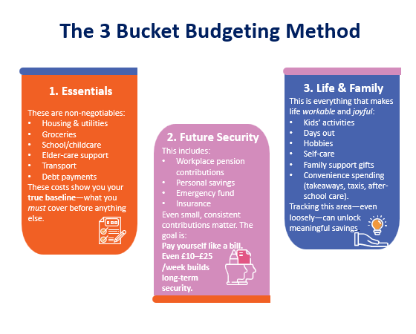
Budgeting in Mid-Life
At this point in your life and career, the demands on your time and resources can seem overwhelming. You want to focus on building your career, yet if you are a parent or caring for elderly relatives, you have commitments that must be met. It can be a challenge to allocate time and money to planning for your retirement, yet it is something you must do. You must create a budgeting approach that reflects your real life, not a perfect life.
Why Budgeting Looks Different In Mid-life
Common pressures:
Irregular expenses (school trips, childcare spikes, medical or elder‑care costs)
Time poverty, making it hard to track finances regularly
Competing priorities between family needs and personal retirement savings
Emotional spending triggers such as guilt, exhaustion, or trying to “make up” for limited time with children
Your budget needs to flex with real circumstances, not force you into unrealistic expectations.
The 3‑Bucket Mid‑Life Budgeting Method
To simplify budgeting while juggling multiple responsibilities, we use 3 buckets:
Activity
Download the Budgeting Template and enter your planned and actual expenditure from our Module 1 resource pack
Review the difference and identify one small change you could make each month that supports long-term financial wellbeing

Slide 19
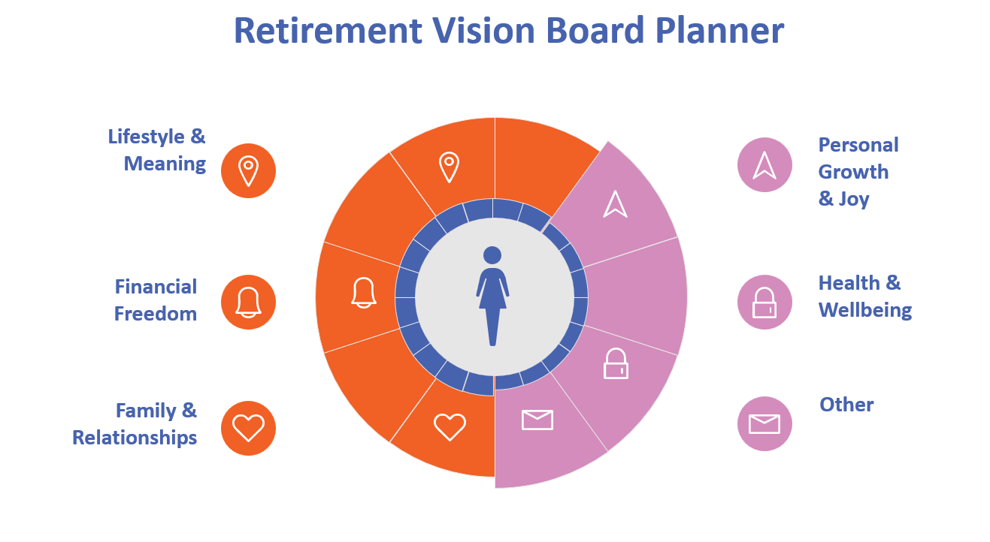
Women in Mid Career
Introduction
Creating a Retirement Vision Board with Financial Goals
Retirement is a life stage you get to design. Many women spend mid‑life giving so much of their time and resources to others that it can feel strange to imagine a phase of life centred around their own wellbeing.
A useful exercise is to consider what you want your retirement to feel like. Creating a vision board helps translate abstract ideas like ‘security’, ‘freedom’, ‘travel’, ‘more time’ into concrete visual objectives to help motivate you.
A retirement vision board is a visual tool that brings your future to life. It can include:
Images (holidays, hobbies, home environment, family moments)
Words or phrases (e.g., “calm mornings,” “financial independence,” “volunteering”)
Financial anchors such as:
Desired retirement age
Annual income needed
Mortgage status at retirement
Savings goals
Plans for caring responsibilities
The purpose is not perfection—it’s direction.
Activity
Create Your Own Retirement Vision Board
Use a sheet of paper of digital tool like Canva or PowerPoint
Divide your page into the six sections illustrated above
Add:
Words or phrases describing what you want
Images
2-3 financial goals connected to each vision area
Identify the one area you want to focus on during this course
Conclusion

Slide 20
Conduct a Personal Retirement Audit
Introduction
A Personal Retirement Audit helps you understand your strengths, your gaps, and the steps you can take to move forward—no matter what season of life you’re in. Mid‑career is a uniquely demanding stage. Many women are juggling full‑time work, part‑time work, childcare, and the increasing needs of ageing parents.
These pressures often push retirement planning to the bottom of the list. Yet even small bits of clarity can create confidence and direction. A retirement audit is not an exercise in perfection or judgment. It is simply a clear map of your current situation, so you can make informed choices about your future.
The Four Areas Of A Personal Retirement Audit
1. Your Current Financial Position: This includes workplace pensions (pot values, contribution levels), Personal pensions, or other savings. Mortgage status and major debts. Emergency fund levels, Entitlements from previous employers.
Why this matters: This gives you a realistic starting point for building your long‑term plan.
2. Your Retirement Lifestyle Goals: This is based on your earlier vision board activity. What lifestyle do you want? Where you want to live? Desired retirement age? Estimated monthly/annual income needed?
Why this matters: It helps you compare where you are vs. where you want to be.
3. Family & Caregiving Responsibilities: Mid-career women often support multiple generations. Reflect on your current caregiving duties, future expectations (e.g., parents needing more support), whether you may be supporting adult children and the impact on your working life and ability to save.
Why this matters: These responsibilities shape both your timeline and your financial choices.
4. Strengths, Risks & Opportunities: Identify what’s already working well, your biggest risks (e.g., career breaks, health, income volatility), your opportunities (e.g., employer matching, upskilling, consolidating pensions)
Why this matters: This section highlights the low‑effort, high‑impact moves you can take.
Activity
Complete your own Personal Retirement Audit
Use the worksheet on the next page
Complete each section with clear and honest reflections
Identify your top three actions to take in the next 30 days
Use this to build a personalised retirement strategy
Conclusion

Slide 21
Personal Retirement Audit Worksheet
Use this worksheet to assess your current retirement readiness across finances, lifestyle, caregiving responsibilities, and long‑term goals. Complete each section honestly to identify strengths, gaps, and next steps.
Current Financial Position
What pension pots do you currently have? List providers and approximate values.
What percentage of your salary are you contributing to a workplace pension?
Do you have any personal pensions or ISAs? List balances.
Do you have an emergency fund? If so, how many months of expenses does it cover?
Current mortgage balance and years remaining.
2. Retirement Lifestyle Goals
What age would you ideally like to retire?
Describe your ideal retirement lifestyle (where you live, activities, pace of life).
What are your expected monthly/annual expenses in retirement?
3. Family & Caregiving Responsibilities
Do you have current caregiving responsibilities? (children, ageing parents, others)
How might these responsibilities change in the next 10–20 years?
Do you anticipate providing financial support to family members in retirement?
4. Strengths & Opportunities
List your financial strengths (e.g., consistent contributions, home ownership, stable job).
List opportunities to increase retirement readiness (e.g., employer match, upskilling, reducing debt).
5. Gaps & Risks to Address
What concerns you most about your retirement planning?
Where are the biggest gaps in your financial knowledge or preparation?
What risks might impact your retirement (job stability, health, time out for caregiving)?
6. Actions to Take in the Next 30 Days
Action 1:
Action 2:
Action 3:

Slide 22
Catch-up Strategies
Many mid‑career women feel they are ‘behind’ on retirement savings due to career breaks, caregiving, part‑time work, or simply the financial pressures of mid‑life.
The good news is that across the European Union, there are practical and increasingly supported ways to catch up. Here are some realistic strategies that can help you boost your long‑term financial security even if you’re starting later or saving irregularly.
Increase Contributions to Supplementary (Occupational or Personal) Pensions
The EU is actively encouraging citizens to make better use of occupational and personal pension schemes, especially since public pensions alone may not sustain future living standards.
Catch-up strategies:
Increase your workplace pension contribution by 1–3% if income allows.
If your employer offers matching, aim to contribute enough to receive the full match.
Consider opening or adding regular amounts to a personal pension product (e.g., a national personal pension plan or a PEPP provider). https://finance.ec.europa.eu/news/ensuring-adequate-retirement-income-eu-citizens-2025-11-20_en
2. Consolidate Old Pension Pots Across Employers
Many women have worked part-time, taken career breaks, or changed employers during childcare or caregiving years. Because EU citizens often struggle to understand what they are entitled to across multiple schemes, the Commission is developing a pension tracking systems that combine information in one place.
Catch-up strategies:
Request statements from all previous employers.
Consolidate small dormant pots where national rules allow.
Use national pension dashboards (available or upcoming in several EU countries) once implemented. https://www.findyourpension.eu/about-ets
3. Enrol in an Auto‑Enrolment Scheme
The EU is recommending auto‑enrolment as a default for supplementary pensions, with opt‑out flexibility. Auto‑enrolment has been proven to increase participation, especially among women and lower‑income workers.
Catch‑up strategies:
If your country or employer offers auto‑enrolment, remain enrolled.
If it doesn’t yet, ask your HR department about voluntary participation.
Increase contributions gradually—“set it and forget it.”
4. Use Behavioural Tools to Make Saving Easier
Financial education alone doesn’t work; women benefit most from behavioural tools like digital calculators, personalised projections, and “nudges” that encourage consistent saving.
Catch‑up strategies:
Set automatic monthly transfers to your pension or savings account.
Use your pension provider’s digital dashboard to model future scenarios.
Schedule a quarterly “retirement check‑in” to track progress. https://www.ecmi.eu/sites/default/files/saving_for_retirement_is_hard_-_but_the_eu_can_make_it_easier_ida_n_23.pdf

Slide 23
Catch-up Strategies
5. Build a Stronger Emergency Buffer to Prevent Pension Interruptions
Research from European pension surveys highlights that many mid‑career women stop contributing during periods of income pressure, leading to long-term savings gaps. Building liquidity helps prevent this.
Catch‑up strategies:
Aim for 3–6 months of expenses as an emergency fund.
During caregiving spikes, reduce—rather than stop—pension contributions.
Use one-off income (bonuses, tax refunds) to rebuild buffers.
6. Look for Tax Efficient Savings Options
Tax incentives are widely used across EU member states to support personal pensions, though effectiveness varies by income level.
Catch-up strategies:
Check your country's tax relief for personal pension contributions.
If you work part-time, explore whether you still qualify for pension tax incentives.
Use tax-advantaged accounts every year, even with small amounts.
7. Consider Late Career Upskilling to Increase Income Capacity
Research shows that labour market stability and higher wages strongly influence long-term pension adequacy. Upskilling in midlife can create additional earning power for savings.
Catch-up strategies:
Take employer-funded training to access higher pay roles.
Explore flexible career shifts that offer better pension benefits.
Use pay increases to boost pension contributions rather than lifestyle spending.
8. Prepare for Caregiving Costs That Could Affect Savings
Many women face future caregiving responsibilities for ageing parents, and these costs can impact long term planning. EU policy discussions highlight this as a major risk to retirement adequacy, especially for women. [euronews.com]
Catch-up strategies:
Plan a “caregiving cushion” in your savings strategy.
Explore national care benefits or allowances that reduce personal expenses.
Protect your ability to remain connected to the labour market.
Activity
Reflect on the catch-up strategies outlined and write down:
Which of the 8 catch‑up strategies feels most realistic right now?
Which one could make the biggest difference over the next 12 months?
What is one small step they can take this month?(e.g., increase pension contribution by 1%, consolidate an old pot, schedule a pension provider meeting)

Slide 24
Preparing for Major Life Events
Midlife is a powerful stage: you have experience, awareness, and often competing priorities. Retirement planning is about preparing for life events that can change your financial path, such as divorce, health changes, or relocation. It is important to build resilience and flexibility into your long‑term plan.
Separation or Divorce
Divorce can significantly reduce retirement assets and income.
What to do now:
Know what you own: Understand all accounts where retirement savings accumulate—state pension entitlements, occupational pensions, private pension pots.
Check benefit-sharing rules: In many EU countries, pension assets accrued during marriage can be split. Knowing how this works in your country helps you assess long‑term security.
Keep your own credit and accounts active: Maintaining individual accounts protects financial continuity.
Health Changes
Chronic illness or early exit from the workforce can reduce lifetime earnings and accelerate the use of savings.
What to do now:
Review your social protection rights: Disability benefits and sickness insurance vary across EU member states.
Consider voluntary pension contributions: If you expect career breaks, topping up pension gaps later can prevent reduced retirement benefits.
Maintain preventive health care: Regular screenings and healthy habits are not only for wellbeing—they also help you remain employable longer.
Relocation (within or outside the EU)
Mid‑life moves for family reasons, career changes, or retirement can affect taxes, pensions, and healthcare rights.
What to do now:
Check pension portability: EU pensions are largely portable within the EU/EEA. Make sure you understand how your contributions transfer and how benefits are calculated.
Compare the cost of living in destinations: Lower expenses may stretch retirement income further.
Review healthcare access: Know how coverage changes if you move, especially long-term
When planning your retirement, it is not always possible to predict the future, but it is important to prepare for possibilities. By strengthening your financial independence today, you give your future self choices, stability, and the ability to navigate whatever challenges life brings.

Slide 25
Introduction
Preparing for Major Life Events
Midlife is a powerful stage: you have experience, awareness, and often competing priorities. Retirement planning is about preparing for life events that can change your financial path, such as divorce, health changes, or relocation. It is important to build resilience and flexibility into your long‑term plan.
Separation or Divorce
Divorce can significantly reduce retirement assets and income.
What to do now:
Know what you own: Understand all accounts where retirement savings accumulate—state pension entitlements, occupational pensions, private pension pots.
Check benefit-sharing rules: In many EU countries, pension assets accrued during marriage can be split. Knowing how this works in your country helps you assess long‑term security.
Keep your own credit and accounts active: Maintaining individual accounts protects financial continuity.
Health Changes
Chronic illness or early exit from the workforce can reduce lifetime earnings and accelerate the use of savings.
What to do now:
Review your social protection rights: Disability benefits and sickness insurance vary across EU member states.
Consider voluntary pension contributions: If you expect career breaks, topping up pension gaps later can prevent reduced retirement benefits.
Maintain preventive health care: Regular screenings and healthy habits are not only for wellbeing—they also help you remain employable longer.
Relocation (within or outside the EU)
Mid‑life moves for family reasons, career changes, or retirement can affect taxes, pensions, and healthcare rights.
What to do now:
Check pension portability: EU pensions are largely portable within the EU/EEA. Make sure you understand how your contributions transfer and how benefits are calculated.
Compare the cost of living in destinations: Lower expenses may stretch retirement income further.
Review healthcare access: Know how coverage changes if you move, especially long-term
When planning your retirement, it is not always possible to predict the future, but it is important to prepare for possibilities. By strengthening your financial independence today, you give your future self choices, stability, and the ability to navigate whatever challenges life brings.
Activity
Download and complete the Retirement Outlook Worksheet from our Module 1 resource pack
Are you saving enough to achieve this?
Discussion
Consider the topics below for a group discussion, or to reflect on for yourself.
Overcoming retirement planning obstacles
What would you do if you needed to retire 5 years early?
Resources
Table
Key To Retirement Systems in the EU
Podcasts
What Every Midlife Woman Needs to Know About Money and Retirement Planning
The ultimate guide for Women and Pensions
Conclusion

Slide 26
04
RETIREMENT
PLANNING FOR
WOMEN IN
LATE CAREER

Slide 27
Women in Late Career
Introduction
As women enter the late career stage, retirement planning takes on a new level of urgency and opportunity. This period is often shaped by unique financial experiences such as career breaks, caregiving responsibilities, part-time work, or changes in health, which can influence pension entitlements and long-term security.
At this stage, it becomes essential to review accumulated retirement savings, understand expected income from state and workplace pensions, and assess whether current contributions align with desired retirement goals.
Women may also need to plan for potential life transitions such as relocation, evolving health needs, or supporting family members.
Learning Objectives
Prepare emotionally and financially for the retirement transition.
Estimate future income vs. expenses.
Explore supplemental income opportunities.
Learn how to manage pensions, withdrawals, and assets.
Content:
Consolidating pensions and simplifying accounts.
Planning withdrawals: annuities, lump sums, and budgeting.
Dealing with gaps: working part-time, renting property, passive income.
Preparing for healthcare and unexpected costs.
Activities:
Build a realistic retirement monthly budget.
Write a “retirement vision statement.”
Role-play: Discussing retirement options with a financial advisor.
Formative Assessment:
Journal prompt: How do you feel about your current retirement plan?
Retirement quiz: Identify risky assumptions in common retirement myths.
Resources:
Glossary of financial terms
Pension consolidation services.
Healthcare cost estimation tools.
Local pension advisory centres.
Conclusion

Slide 28
Women in Late Career
Introduction
Consolidating Pensions And Simplifying Accounts
As you move through the final phase of your career, consolidating your pensions and simplifying your retirement accounts can make a significant difference to your long‑term financial wellbeing. Many women in Europe reach their 50s and early 60s with multiple pension pots—often accumulated through career breaks, part‑time roles, or moves between employers or countries. Consolidating these accounts can help reduce fees, make investment performance easier to track, and give you a clearer picture of your total retirement income.
A good starting point is to review all existing pension pots and consider whether merging them into one modern, low‑fee scheme could improve your projected retirement outcomes.
Online tools can help:
The People’s Pension’s Pension Consolidation Calculator lets you model what your combined savings might look like if pots are merged into a single account, giving an estimate of future value and potential fee savings. If you'd like to compare the growth of consolidated pensions over time
The Money Saving Advisors’ Pension Consolidation Calculator offers forecasts, fee comparison, and potential retirement income estimates. This is particularly useful if your pensions were built across different employers or older schemes with varying charges.
The European Insurance and Occupational Pensions Authority (EIOPA) provides consumer‑focused guidance on pension planning across EU countries, including the shift from defined benefit to defined contribution schemes and how mobility between jobs or countries affects savings. Their platform highlights the importance of planning early, understanding tracking systems, and preparing for life expectancy and income variability in retirement
By consolidating and simplifying now, you equip yourself with a clearer, more manageable view of your retirement future—helping you feel more confident and in control as you transition into the next stage of life.
Video
Watch this video, which outlines the key things to consider when consolidating your pensions and simplifying your accounts.
Pension Consolidation: What it is and how it works
Conclusion

Slide 29
Women in Late Career
Introduction
Tips
Activity
Planning withdrawals: annuities, lump sums, and budgeting
As you approach retirement, one of the most important steps is deciding how you will turn your pension savings into a reliable income. For many women in late career, especially those with varied work histories across Europe, understanding withdrawal options can make a meaningful difference to long‑term financial security.
You will typically have three main pathways:
taking a lump sum
purchasing an annuity
managing flexible withdrawals through drawdown.
A lump sum can offer freedom; it is useful for paying off debts or creating an emergency buffer, but it also reduces the money available for future income, so it’s important to use it wisely. Annuities, on the other hand, convert part of your pension into a guaranteed income for life, which can be reassuring if you’re concerned about outliving your savings. Flexible drawdown gives you control over how much you withdraw each year, but it also requires careful budgeting and monitoring to ensure your pot lasts throughout retirement.
Whichever option you choose, a realistic retirement budget is essential. This includes estimating essential costs like housing, utilities, healthcare, and insurance, while also planning for lifestyle choices such as travel, hobbies, or supporting family members. Women often live longer than men and may face later-life health changes, making it especially important to pace withdrawals and keep a cushion for unexpected expenses.
By understanding your withdrawal options and aligning them with a thoughtful budget, you can create a retirement income plan that supports both security and flexibility, allowing you to move confidently into the next stage of life.
`
Create a realistic retirement monthly budget for yourself
Family Finance Budgeting Tool
Tips
Once you have gathered and organised your personal information, make an appointment with a financial advisor to ensure you are maximising your benefits and income
Write
Take a few minutes and create a ‘Retirement Vision Statement’ that is tailored to you, your needs and your circumstances
Take a few minutes to answer, how do you feel about your current retirement plan?
Conclusion

Slide 30
Women in Late Career
Introduction
Dealing With Gaps: Working Part-time, Renting Property, Passive Income.
As you approach retirement, it’s common to notice gaps between your expected pension income and the lifestyle you want to maintain. Many women in late career have experienced career breaks, part-time work, or caregiving responsibilities that can reduce pension contributions.
The good news is that there are several practical ways to strengthen your financial position in the years leading up to retirement. Continuing to work part-time can help extend your savings, boost your state and workplace pension entitlements, and ease the transition out of full-time employment. Even a few additional years of part-time income can make a meaningful difference to long-term financial security.
If you own property, renting out a room or a second home can provide steady supplemental income. This can be especially helpful as many European cities offer strong demand for affordable accommodation. Alternatively, if you prefer not to manage tenants, some women explore short-term or holiday rentals. However, it is important to check local regulations and tax obligations.
Beyond property, passive income streams such as dividend-paying investments, low-risk bond funds, or income-generating ETFs can help fill income gaps while keeping your retirement portfolio diversified.
For those seeking more flexibility, supplemental income opportunities like consulting, tutoring, freelance project work, or turning a hobby into a small business can also provide meaningful financial support while maintaining your independence and control over your time.
By combining part-time work, thoughtful use of property, and appropriate passive income strategies, you can create a more stable and resilient retirement income plan—one that helps you feel prepared, confident, and in control of your next chapter.
Preparing for healthcare and unexpected costs.
Preparing for healthcare and unexpected costs is an essential part of late‑career retirement planning. Women often face longer life expectancy and may experience increased medical needs over time, making it important to build a financial buffer for both routine and unforeseen expenses.
This includes understanding what your national healthcare system covers, exploring supplemental health insurance if appropriate, and setting aside a dedicated emergency fund to manage surprises such as home repairs, mobility aids, or caregiving support.
By planning ahead and factoring these potential costs into your retirement budget, you can protect your long‑term financial stability and reduce stress during periods of change.
Conclusion

Slide 31
Quiz: Spot the Risky Assumption in These Retirement Myths
Quiz
Read each statement and choose the answer that best identifies the risky assumption hidden in the myth. Answers on the following page..
“I’ll rely on my state pension—it should be enough to live comfortably.”
A. State pensions across Europe fully replace previous income
B. State pensions may not cover full living costs
C. State pensions increase automatically with your desired lifestyle
2. “I’m healthy now, so I won’t need to save extra for medical or long‑term care.”
A. Health will remain stable indefinitely
B. Health insurance always covers everything
C. All future medical treatment will be low‑cost
3. “I’ll just work a few more years if I need more money.”
A. Employers guarantee work for older employees
B. You will always be able to work full‑time
C. Career opportunities steadily increase with age
4. “My investments will keep growing—it’s always safe to withdraw more later.”
A. Markets are predictable
B. Investments never lose value in retirement
C. Future investment returns will always match past performance
5. “I don’t need to check old pension pots—everything will sort itself out.”
A. Pension providers automatically consolidate accounts
B. Older pensions always charge low fees
C. You already know exactly what your retirement income will be
6. “I’ll downsize my home and easily free up cash when I retire.”
A. Property markets always rise
B. You’ll find a suitable, smaller home at the right price
C. Selling will be quick and stress‑free
7. “I won’t need a budget—retirement expenses are lower anyway.”
A. Spending naturally decreases with age
B. Travel, hobbies, and family support cost very little
C. Unexpected costs will never occur

Slide 32
Women in Late Career
Introduction
Answer Key With Explanations
Answer: B — State pensions may not cover full living costs
State pensions often replace only part of your previous income. Inflation, housing costs, and healthcare needs can outpace state benefits, creating a shortfall.
2. Answer: A — Health will remain stable indefinitely
Health needs usually increase with age. Even with public healthcare, out-of-pocket costs such as dental care, mobility aids, or home support can strain retirement budgets.
3. Answer: B — You will always be able to work full-time
Late-career workers may face age discrimination, health limitations, or caregiving duties. Relying on late retirement income can be risky if work availability changes.
4. Answer: C — Future returns will always match past performance
Markets fluctuate, and downturns can significantly reduce retirement funds—especially if major withdrawals are made during poor market periods.
5. Answer: A — Pension providers automatically consolidate accounts
Old pension pots can become “lost” or eroded by high fees. Reviewing and tracking them is essential to avoid missing out on income.
6. Answer: B — You’ll find a suitable smaller home at the right price
Housing markets vary greatly by region. Downsizing costs—agents’ fees, taxes, renovations—can reduce available equity and delay plans.
7. Answer: A — Spending naturally decreases with age
Many retirees spend more in early retirement (travel, family support) and face rising costs later (healthcare, home maintenance). Budgeting is essential at every stage.
Local Pension Advice
Germany
Startseite | Deutsche Rentenversicherung
Ireland
Home - National Pension Helpline
Cyprus
Pension Rights | EURAXESS
Netherlands
Pension advice - Buro Zwiers
These are examples of some local pension advice centres and resources, there are many others and you should research to find the one that best suits your needs
Conclusion

Slide 33
05
CONCLUSION

Slide 34
Conclusion
Introduction
Retirement planning is not a single decision but a lifelong process that evolves as women move through early, mid, and late career. Throughout this module, you have explored how your personal circumstances, work patterns, family responsibilities, health, and financial resources shape your long‑term security.
You have learned how to set realistic goals, review and strengthen your pension contributions, and adapt your strategies as your life changes. Most importantly, you now understand that retirement planning is about more than accruing savings; it is about building confidence, independence, and the freedom to design the future you want.
Across Europe, women face unique challenges such as career interruptions, part‑time work, caregiving duties, and longer life expectancy. Yet, as this module has shown, you also have powerful tools at your disposal. Whether it’s consolidating pension pots, catching up through smarter contributions, planning for withdrawals, exploring supplemental income, or preparing for unexpected costs, every step you take strengthens your financial resilience.
By engaging with these resources, reflecting on your goals, and taking informed action, you are investing in a retirement that supports your wellbeing, choices, and dignity.
As you complete this module, remember that planning for retirement is an ongoing commitment—but one that brings clarity and empowerment with each step. Continue to use the tools, checklists, and activities provided, seek advice when needed, and revisit your plan regularly. Your future self will thank you for the decisions you make today.
Conclusion

Slide 35


Website Here
Follow Our Journey
www.fempower.finance

