Slide 1



MONEY IN EVERYDAY LIFE:
BUDGETING AND MANAGING
FINANCES
www.fempower.finance
This publication is licensed under a Creative Commons Attribution-Non Commercial-ShareAlike 4.0
International (CC BY-NC-SA 4.0) Licence with exception of all logos and any material in this document where noted.

Slide 2
IMPRINT & DISCLAIMER
This resource has been developed within the context of the Erasmus+ project “FEMpower in Finance: Upskilling women in sustainable financial literacy to raise their confidence and counter the threat of old age poverty.”
The information, explanations, calculations, examples, and any related materials provided through this resource are intended exclusively for educational and informational purposes. They are designed to support learning activities in financial literacy. They do not constitute financial, investment, legal, tax, accounting, or any other professional advice.
No Financial or Investment Advice
Nothing in the resources provided by the project should be interpreted as a recommendation to buy, sell, hold, or otherwise transact in any financial product, nor as guidance on any individual investment / financial strategy. Users should seek independent advice from qualified professionals before making financial decisions.
No guarantee of accuracy or suitability
While reasonable efforts have been made to ensure that our resources are coherent and usable, the project partners and authors provide them “as is” and make no representations or warranties (express or implied) regarding completeness, correctness, timeliness, fitness for a particular purpose, or outcomes achieved through their use. Financial results and projections may vary significantly depending on personal circumstances, assumptions, market developments, and user inputs.
User responsibility for inputs and outcomes in templates
Users are solely responsible for
the accuracy of all data they enter,
the assumptions they apply, and
any actions they take based on outputs generated by the resources provided. Any figures shown are indicative only and may be affected by rounding, methodology choices, or spreadsheet software settings.
Limitation of liability
To the fullest extent permitted by applicable law, the project partners, authors, and associated organisations shall not be liable for any direct or indirect loss or damage (including financial loss, lost profits, or consequential damages) arising from the use of, inability to use, or reliance on the resources of the project.
Third-party sources and links
Where resources reference external sources, tools, or links, these are provided for convenience and learning. The project partners do not control such third-party content and do not endorse or accept responsibility for it.
Erasmus+ context and responsibility statement.
This resource is produced for learning purposes in the framework of the FEMpower in Finance project. The views expressed in this template are those of the authors and do not necessarily reflect the official position of the European Union or any National Agency; neither the European Union nor the granting authority may be held responsible for any use made of the information contained herein.”
Content Developers
The FEMpower in Finance Project consortium
(2026-2022) is a joint project by
Tvw GmbH - Germany
UCLAN Cyprus Limited - Cyprus
Momentum Educate and Innovate - Ireland
The Hub Nicosia - Cyprus
Stichting Go Woman Alliance Europe – Netherlands
Publication date: May 2026

Slide 3

01
Introduction 4
page
page
page
02
10
03
20
04
29
Women in Early Career
Women in Mid Career
Women in Late Career
05
Conclusion 37

Slide 4
01
INTRODUCTION

Slide 5
Introduction
Introduction
“Small steps every day add up to big results over time.”
Money management is not only about numbers. It is about creating stability in everyday life and protecting your ability to make choices, today and in the future. Budgeting and managing finances means having a clear overview of what money comes in, what money goes out, and how to plan for both expected and unexpected costs. It is not a strict set of rules. It is a practical method that helps you feel more confident and prepared.
In daily life, financial pressure often comes from small and repeated decisions: regular bills, food and transport costs, subscriptions, children’s needs, health-related expenses, or sudden repairs. Without a simple system, it is easy to lose track, overspend without noticing, or feel anxious about checking your bank account. A realistic budget gives you clarity. It helps you prioritise essentials, plan for irregular costs, and reduce stress when life becomes unpredictable.
For many women, everyday money management requires extra attention because women’s financial lives are often shaped by structural and life-course realities. Women are more likely to experience income gaps due to part-time work, career breaks, or periods of unpaid caregiving.
This module aims to equip women of all ages with the tools, knowledge, and confidence to manage everyday finances through clear, realistic budgeting practices. To achieve these aims, the module uses simple financial terminology that can be understood by women of different ages and career stages, irrespective of educational background.
This module is designed to help women in the EU strengthen everyday financial control and reduce financial stress. It provides practical routines, examples, and tools to support budgeting decisions across different life stages. The module aims to empower women to build financial stability in the present, while also creating the foundation for saving and longer-term financial security.
Learning Objectives
By the end of this module, you will be able to:
Understand the concept of budgeting and everyday financial management.
Identify your income sources and classify your expenses (fixed, variable, irregular).
Create a realistic monthly budget that reflects your personal situation.
Track spending in a simple way and recognise patterns that affect your financial stability.
Plan for bills and irregular costs so that “money surprises” become less stressful.
Make small, sustainable changes that improve control, confidence, and financial wellbeing.
Why budgeting and everyday money management is particularly important for women:
Women are more likely to have income interruptions due to caregiving responsibilities.
Women are more likely to work part-time, which can limit financial buffers.
Women often carry a larger share of household planning and financial “mental load”.
Lower lifetime earnings can make day-to-day financial stability more fragile during transitions.
Strong budgeting skills support independence, reduce stress, and build confidence for future decisions.
Conclusion

Slide 6
Your Personal Situation
Your budget is personal to you. It reflects your daily reality, your responsibilities, and your priorities. To create an effective budget for yourself, you must consider your personal situation and how it changes across your lifetime. Your money management needs will be influenced by several factors, including:
1. Income Type and Stability
Do you have a stable monthly income, irregular income, fixed income, or a combination?
2. Household and Family Responsibilities
Do you manage finances for yourself only, or also for children, a partner, or other family members?
3. Housing Situation
Rent, mortgage, shared housing, living alone, or living with family all affect your fixed costs and flexibility.
4. Fixed Monthly Costs
Regular bills such as rent, utilities, insurance, transport passes, debt repayments, subscriptions.
5. Variable Spending Patterns
Costs that change each month, such as groceries, leisure, clothing, and children’s needs.
6. Irregular and Seasonal Costs
Annual or occasional costs such as repairs, gifts, holidays, medical expenses, school-related payments.
7. Debt and Payment Commitments
Any loans, credit cards, overdrafts, or “buy now, pay later” obligations that reduce monthly flexibility.
8. Financial Buffer and Emergency Readiness
Do you have savings for unexpected costs, and if yes, how long would they last?
9. Personal Goals and Priorities
Short-term goals (e.g., stabilising bills), medium-term goals (e.g., education, moving), and long-term goals (e.g., security and saving).
Once you have considered your personal situation, you can start to determine the budgeting approach that suits you best. The first step is to build a simple overview of your income and expenses and test a budgeting method that feels realistic for your life.

Slide 7
Glossary
Annual-to-monthly approach – A method where you estimate a yearly cost (for example gifts or repairs) and divide it by 12 to set aside a monthly amount.
Banking overview method – A simple tracking method where you review your bank transactions and group spending into categories.
Bill (regular bill) – A payment you must make, often on a fixed schedule, such as rent, utilities, phone, or insurance.
Budget – A plan that shows what money comes in, what money goes out, and how you will manage it in everyday life.
Budget category – A labelled group of expenses (for example housing, food, transport) used to organise and understand spending.
Budget shock – A stressful moment when an irregular cost appears and disrupts your monthly plan because it was not prepared for.
Buffer (financial buffer) – Money set aside for unexpected costs so you do not have to rely on overdrafts or short-term credit.
Care-related costs – Expenses linked to caring responsibilities, such as childcare payments, school needs, or support for relatives.
Convenience spending – Small purchases that feel helpful in the moment (for example delivery fees or quick snacks) but can add up over time.
Debt repayment – A regular payment you make to pay back money you borrowed (loan, credit card balance, instalments).
Discretionary spending – Spending that is optional rather than essential, such as leisure, hobbies, or non-necessary shopping.
Emergency readiness – How prepared you are to handle an unexpected cost without financial panic or harmful debt.
Essential costs (essentials) – Costs that must be covered to keep daily life stable, such as housing, utilities, food, transport, and key health needs.
Expense – Money you spend, including bills, daily costs, and irregular payments.
Financial confidence – Feeling able to understand your money situation and make decisions without fear or avoidance.
Financial stress – Worry or pressure caused by uncertainty about money, bills, or the ability to handle costs.
Fixed costs (fixed expenses) – Costs that stay similar each month, such as rent or mortgage, insurance, subscriptions, or transport passes.
Flexible costs (flexible spending) – Costs you can adjust more easily from month to month, such as leisure, eating out, or non-essential shopping.
Fraud (financial fraud) – When someone tricks you into giving money or information by pretending to be a trusted person or organisation.

Slide 8
Glossary
Household costs – Costs linked to running a home and daily life, often connected to household and family needs (for example housing, utilities, groceries).
Income – Money you receive, such as salary, freelance income, benefits, allowances, or support payments.
Income stability – How predictable your income is (stable monthly income, irregular income, or fixed income such as a pension).
Irregular costs (irregular expenses) – Costs that do not happen every month but appear during the year, such as repairs, annual fees, medical bills, gifts, or holidays.
Lifestyle inflation – When spending increases as income increases, so it becomes harder to save or build a buffer.
Mental load (financial mental load) – The hidden work of remembering, planning, and coordinating money tasks (bills, school needs, household planning).
Monthly review – A short monthly check where you look at your budget, update amounts, and adjust for upcoming costs.
Net income – The money that actually arrives in your account after tax and deductions.
Overdraft – A situation where your bank account goes below zero and the bank charges fees or interest for it.
Payment commitment – A regular obligation to pay something, such as a loan repayment, subscription, or instalment plan.
Phishing – A scam message (email, SMS, or call) designed to steal your passwords, banking details, or security codes by pretending to be real.
PIN – A secret number used to access a bank card or account; it should never be shared with anyone.
Predictable income (fixed income) – Income that is stable and regular, such as a pension, benefit payment, or a fixed salary.
Priority-based budgeting – A budgeting approach where you protect essentials first, then plan irregular costs, and then decide what is flexible.
Recurring costs – Costs that repeat regularly (monthly, quarterly, or yearly), such as subscriptions, memberships, or service contracts.
Remote access – When someone gains control of your computer or phone from a distance; scammers may ask for this to steal money or data.
Safety margin – A small amount left in your monthly plan after essentials and planned costs, to reduce anxiety and absorb small surprises.
Scam – A dishonest trick designed to pressure you into sending money or sharing private information.
Seasonal costs – Costs that appear at certain times of year, such as holidays, heating, school starts, or seasonal clothing.

Slide 9
Glossary
Spending pattern – A repeated habit in how you spend money (for example frequent small purchases, high weekend spending, subscription build-up).
Spending tracking – A method of recording or reviewing spending so you can compare your budget plan with real life.
Subscription – A repeated payment for a service (for example streaming, apps, gym) that continues until you cancel it.
TAN / verification code – A security code used to confirm a banking action; it should never be shared with anyone.
Variable costs (variable expenses) – Costs that change from month to month, such as groceries, leisure, clothing, or children’s needs.
Weekly money check – A short routine (for example 20 minutes) to review balance, upcoming payments, spending, and one improvement action.

Slide 10
02
BUDGETING
FOR WOMEN IN
EARLY CAREER

Slide 11
Women in Early Career
Introduction
Early career is often the first time you manage money fully on your own. You may be receiving your first regular salary, balancing study and work, or dealing with income that changes from month to month. At the same time, many new costs appear: rent and deposits, utilities, commuting, insurance, subscriptions, and everyday living expenses. Because so much feels new, it is easy to feel that money “disappears” quickly, even when you are careful.
In this stage, budgeting is a practical skill that helps you build stability and confidence. A budget gives you a clear overview of what comes in, what goes out, and what you can realistically afford. It helps you avoid unpleasant surprises, such as running out of money before the end of the month, missing a bill, or relying on overdrafts or short-term credit. Most importantly, budgeting supports your independence: when you understand your money, you can make choices that match your priorities.
Budgeting in early career does not need to be complicated. You do not need advanced financial knowledge. You only need a simple routine that you can repeat. Even a basic budget, combined with spending tracking for a short period, can help you recognise patterns, reduce unnecessary costs, and plan better for irregular expenses (for example, annual fees, health costs, or repairs).
This section focuses on building your first budgeting habits in a realistic and supportive way. The aim is to help you create a system that fits your life now, while also laying the foundation for future steps such as saving, investing, and long-term financial security.
Learning Objectives:
Understand the purpose of budgeting and everyday financial management.
Identify your main income sources and your main spending categories.
Distinguish between fixed, variable, and irregular expenses.
Create a simple monthly budget that fits your current life situation.
Use a basic tool (app, spreadsheet, or notebook) to track spending and stay organised.
Content:
What budgeting is and why it matters in everyday life.
Income vs. expenses: how to build a clear monthly overview.
Fixed, variable, and irregular costs: how to plan realistically.
Tracking spending: simple methods that work (notebook, banking overview, app/spreadsheet).
First habits for financial confidence: building routines and avoiding “money surprises”.
Activities:
Create your first monthly budget using a simple template (income, fixed costs, variable costs, irregular costs).
Track your spending for 7 days using one method (notebook, banking overview, or app).
Conclusion

Slide 12
Women in Early Career
Introduction
Formative Assessment:
Reflective question: What spending category surprised you most after tracking for 7 days?
Quick quiz: Decide whether common expenses are fixed, variable, or irregular.
Relevant Resources:
Glossary of financial terms
10 Practical Tips Saving Money
Financial Fraud Prevention Checklist
Buffer Plan Checklist
Health Cost Plan Checklist
Financial Habit Tracker
Simple Budget Template Excel
Conclusion

Slide 13
Budgeting Basics: What is budgeting and why does it matter?
A budget is a basically plan that shows what money comes in and what money goes out. It helps you make everyday decisions with clarity, instead of guessing.
In early career, budgeting matters because many costs are new and easy to underestimate. Examples include rent and deposits, utilities, transport, insurance, subscriptions, and daily expenses such as food. When you do not have a clear overview, it can feel as if money “disappears” quickly. This can lead to stress, missed payments, or using expensive overdrafts and short-term credit.
Budgeting supports your independence. When you know your numbers, you can decide what is realistic for your life right now:
what you can spend each week,
what you should set aside for bills, and
what you can keep for goals or unexpected costs.
Budgeting is not about being strict. It is about being prepared. Even a simple budget can reduce stress because you can see what is possible and what needs to change.
A good budget also creates a foundation for the next steps of financial empowerment. When everyday finances are under control, it becomes easier to save, build a buffer, and plan for the future.
BUDGET

Slide 14
Budgeting Basics: Income vs. Expenses
A budget starts with one clear picture: how much money comes in each month and how much money goes out. This overview is the “map” for your everyday finances. Without it, you may make decisions based on feelings (“I think I can afford this”) instead of facts (“I know what is possible”).
Step 1: Calculate your monthly income
Income is the money you receive. In early career, income can look different from person to person. It may include:
salary from a job (full-time or part-time),
income from internships, freelance work, or side jobs,
scholarships or student support,
benefits, grants, or training allowances,
support payments (for example, family support).
Write down your monthly income after tax (what actually arrives in your account).
If your income is stable, use your normal monthly amount.
If your income changes from month to month, use a simple average: add your income from the last 3 months and divide by 3. This gives you a realistic number to plan with.
Step 2: List your monthly expenses
Expenses are the money you spend. A common mistake is to list only “big” costs and forget smaller items that happen often. Start by listing the most important categories, for example:
housing (rent, utilities, heating),
transport (tickets, fuel, subscriptions),
food (groceries and eating out),
phone and internet,
insurance,
debt repayments (if you have them),
subscriptions (streaming, gym, apps),
personal spending and leisure.
At this stage, you do not need perfect numbers. A good first step is to estimate your expenses based on:
your bank account transactions,
receipts, or
memory (then improve later through tracking).

Slide 15
Budgeting Basics: Income vs. Expenses
Step 3: Compare income and expenses
Now calculate: Income – Expenses = What remains (or what is missing).
If money remains, you can decide what job it should do:
- build a small emergency buffer,
- save for a goal (education, travel, moving), or
- reduce debt faster (if relevant).
If money is missing, the budget is still useful. It shows you that something must change. Typical early-career solutions include:
- reducing variable costs (for example, eating out, subscriptions),
- checking if you are paying for services you do not use,
- planning irregular costs more carefully so they do not disrupt the month,
- looking for realistic ways to increase income over time (for example, more hours, a better contract, or additional income streams).
Important: A budget is not a judgement. It is information. It helps you understand your financial situation and make choices with confidence. Even a simple monthly overview can reduce stress because you know where you stand and what you can do next.
You can access the Budget Template here: LINK
Key Takeaway

Slide 16
Tracking Spending: Simple Methods That Work
A budget is a plan. Tracking is how you check if your plan matches real life.
Many people avoid tracking because they think it will take a lot of time or because they fear what they might find. In reality, tracking can be simple and supportive. It helps you replace uncertainty with facts. Even tracking for a short time (for example, 7 days) can reveal patterns that make budgeting easier.
Tracking spending especially matters in early career because:
you may not yet know what your “normal” monthly costs look like,
small daily spending can add up quickly, and
irregular costs often appear without warning if you do not plan them.
There is a number of simple tracking methods:
Notebook method (very simple, no technology)
Write down every expense for 7 days. Include the amount and a short category (food, transport, leisure). This works well if you pay in cash or prefer a low-tech approach.
Banking overview method (fast, realistic)
Use your online banking history. Once per week, look at your transactions and group them into categories. Many online banking services already provide to see expenses by categories. This works best if most of your spending happens digitally (card payments, transfers, subscriptions).
App or spreadsheet method (structured and reusable)
A budgeting app or a simple spreadsheet allows you to enter expenses quickly and often helps you categorise them. Some tools can visualise where your money goes, which makes patterns easier to see.
Be aware that service providers and banks use your data (e.g. when using apps that are connected to your bank account). Look out for services that can be trusted and that protect your data.
Key Takeaway
!
Be Aware

Slide 17
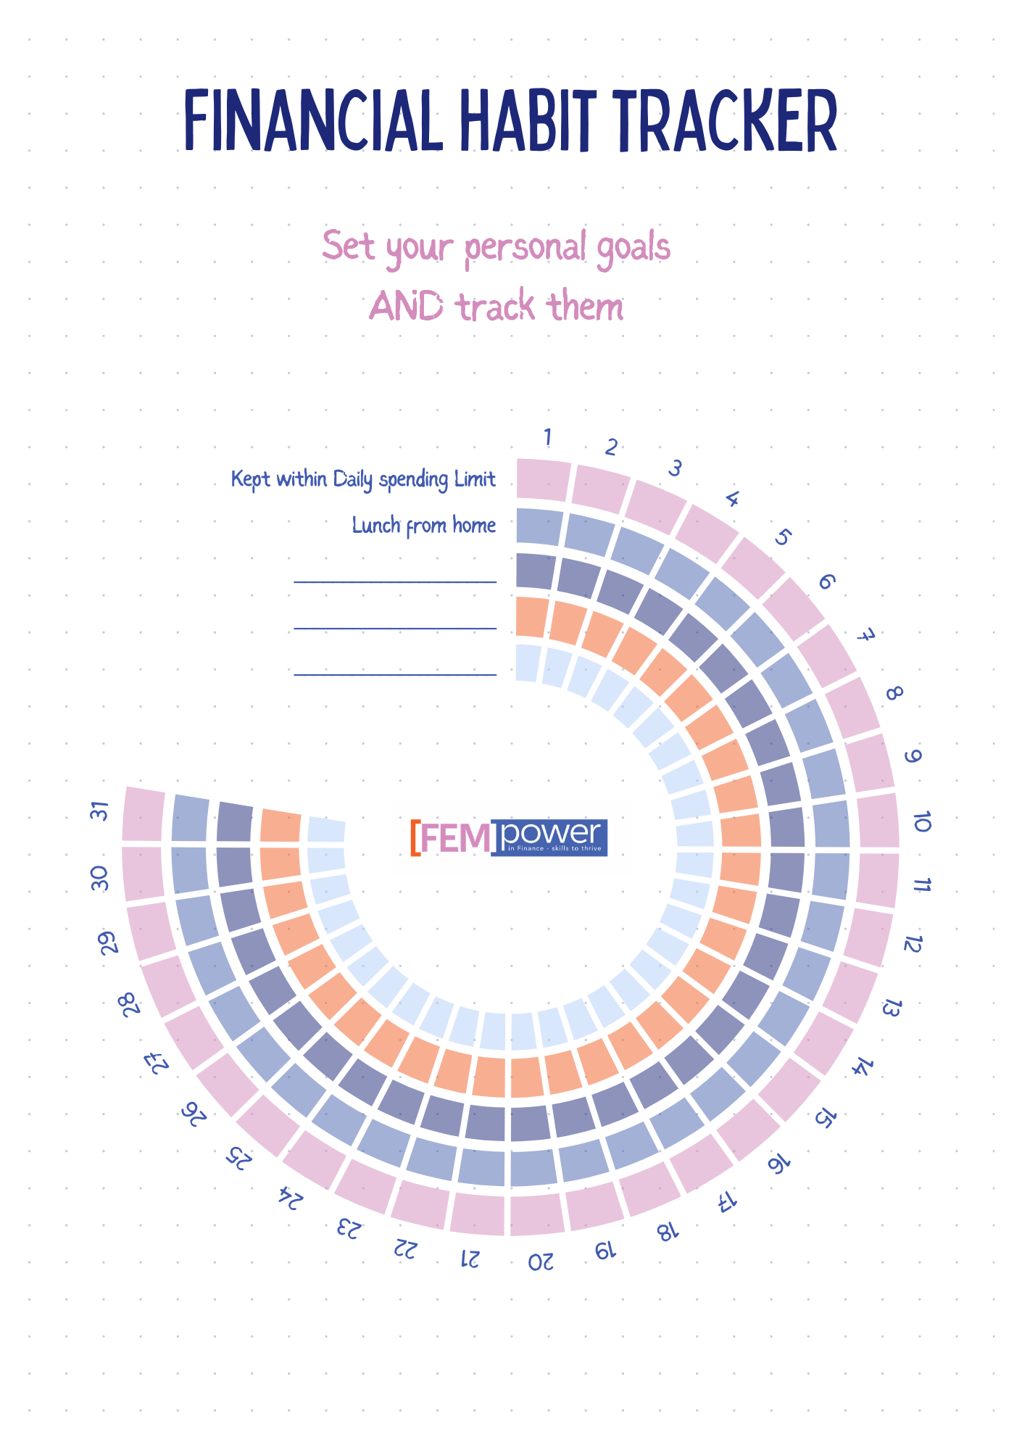
Tracking Spending: Simple Methods That Work
(continued)
What to look for when you track
Tracking is most useful when you look for specific patterns, such as:
subscriptions you forgot you are paying for (especially quarterly / yearly payments are easy to be overlooked and forgotten to plan),
“convenience spending” (delivery fees, frequent small purchases),
categories that cost more than you expected (for example, transport or eating out),
spending linked to emotions or stress (for example, impulse buys).
How to use what you learn
After one week of tracking, choose some realistic actions to test next week. For example:
set a weekly spending limit for leisure,
bring lunch from home twice per week,
cancel one unused subscription,
plan groceries before shopping.
Tracking is not about guilt. It is about clarity. When you know your patterns, you can change them step by step.
Key Takeaway
You can use our Financial Habit Tracker Template (see resources for download link) or just develop your own journal.

Slide 18
Time for Reflection
After tracking your spending for 7 days, answer the following questions in 3-5 sentences and reflect on your answers:
Which spending category was the highest for you?
Which cos surprised you the most?
What is one small spending habit change you can realistically try next week?

Slide 19
Tools that help you budgeting
Introduction
FEMPower Tools
You can use the Budget Template and our Financial Habit Tracker Template available for this module
Resources & Further Reading
Podcasts
Money Clinic with Claer Barrett (Financial Times)
Real-life money questions answered in a practical, relatable format
The Meaningful Money Personal Finance Podcast (Pete Matthew)
Plain-language personal finance with a strong “what you need to know / what you need to do” approach
The Financial Confessions (The Financial Diet)
Accessible discussions about earning, spending, and money behaviours; useful for confidence-building and normalising money conversations.
HerMoney with Jean Chatzky
A women-focused personal finance podcast that regularly covers budgeting and everyday financial decision-making in a supportive tone.
Blog posts and practical guides
MoneyHelper – Budget Planner (free online tool + guidance)
Step-by-step online budget planners; includes categories and practical tips, suitable for first-time budgeting.
Meaningful Money – “The Ultimate Guide to Budgeting” (article + workbook)
A comprehensive but readable guide that explains budgeting logically and practically; good as a “one place to start” article.
Videos
Deutsche Bundesbank – “Budgeting: Budget plan: keeping track of your money” (film + worksheet)
A concise educational video with accompanying worksheet.
Deutsche Bundesbank – “Planning with money” (video with worksheets; English subtitles available)
Practical short film format with supporting materials; developed for secondary level I.
The Financial Diet – “How To Make Your First Budget (At Any Income)” (YouTube video)
Step-by-step explanation aimed at beginners; useful for confidence-building and translating concepts into action.
Conclusion

Slide 20
03
BUDGETING FOR
WOMEN IN
MID CAREER

Slide 21
Women in Mid Career
Introduction
Mid career is often a period of constant coordination. Many women balance work responsibilities with family needs, household administration, and often support for relatives who require care. In everyday life, this can mean that financial decisions are made “in between” everything else: quickly, under pressure, and without enough time to review the bigger picture. As a result, budgeting may feel less like a helpful tool and more like an additional task.
This stage of life is also financially demanding. Costs can increase due to housing, childcare, education, mobility, health-related needs, and the general pressure of “many small expenses” that add up. At the same time, income may not grow in line with responsibilities, especially if working hours are reduced or career choices are influenced by caregiving duties. When time is limited, it is easy to lose track of irregular expenses, forget subscriptions, or underestimate upcoming costs, which can lead to stress, overdrafts, or a lack of savings for emergencies.
Budgeting in mid career therefore needs to be realistic, time-saving, and flexible. It is not about tracking every cent or creating a perfect plan. It is about building a clear overview, prioritising what matters most, and creating simple routines that still work during busy weeks. In this section, we will guide you through practical approaches to review your household spending, plan ahead for irregular costs, and set up a brief weekly “money check” routine. The goal is to reduce stress, strengthen confidence, and help you create a budget that supports both your daily needs and your future stability.
Learning Objectives
Understand how to adapt budgeting to complex responsibilities and multiple goals.
Recognise how care work, time pressure, and “mental load” can affect financial routines.
Strengthen skills for tracking spending, planning irregular costs, and maintaining a financial buffer.
(PLEASE NOTE: for basic budgeting skills and templates please see section 02)
Content:
Budgeting when life is busy: realistic planning and prioritising essentials.
Managing household costs and irregular expenses without losing overview.
Building and protecting a financial buffer for resilience.
Simple routines that reduce stress and strengthen financial confidence.
Activities:
Household budget review: identify your top cost drivers and one improvement area.
Irregular cost calendar: map yearly expenses and divide them into monthly amounts.
Time-saving finance routine: design a 20-minute weekly “money check”.
Formative Assessment:
Self-evaluation checklist: Are you saving enough?
Scenario analysis: What would you do if you needed to retire 5 years early?
Resources:
Glossary of financial terms
10 Practical Tips Saving Money
Financial Fraud Prevention Checklist
Buffer Plan Checklist
Health Cost Plan Checklist
Financial Habit Tracker
Simple Budget Template Excel
Conclusion

Slide 22
Budgeting when life is busy
Introduction
In mid career, the main budgeting challenge is often not knowledge, it is time and complexity. When you have many responsibilities, a budget must be simple and flexible enough to maintain, even in stressful weeks. If a budget is too detailed, it is likely to be abandoned. A realistic budget is one you can actually use.
A practical approach is to focus on three priorities:
Cover essentials first
Start by protecting the expenses that keep daily life stable, such as housing, utilities, food, transport, and key care-related costs. When these are clear, it becomes easier to see what is truly flexible.
Plan for the “hidden” costs
Mid-career life includes many irregular or semi-irregular costs: school activities, birthdays, repairs, seasonal clothing, health appointments, or travel linked to family needs. These costs are common, but they often disrupt the monthly budget because they are not planned. A good budget treats these costs as “expected” and prepares for them in advance.
Protect a buffer, even if it is small
A financial buffer is not only for large emergencies. It also protects you from everyday stress: a broken phone, a car repair, an unexpected invoice, or a temporary income change. If you have no buffer, even small surprises can lead to overdrafts or short-term debt. A buffer gives you breathing space.
To keep budgeting manageable, use a “good enough” routine:
- one short weekly check to stay on track, and
- one monthly review to adjust your plan.
The goal is not to track everything perfectly. The goal is to stay informed, reduce stress, and keep control.
Conclusion

Slide 23
Budgeting when life is busy
Introduction
Activity
Short Activity: “3 Priorities” Budget Check (10 Minutes)
This quick exercise helps you simplify your budget so it works in busy weeks.
Step 1: Essentials (3 minutes)
Write down your 5 most important essential costs (the ones that must be covered each month):
______________________________________________________________
______________________________________________________________
______________________________________________________________
______________________________________________________________
______________________________________________________________
Step 2: Hidden costs (3 minutes)
List 3 costs that often “surprise” you during the month (irregular or easy to forget):
______________________________________________________________
______________________________________________________________
______________________________________________________________
Step 3: Buffer decision (2 minutes)
Choose one small buffer amount you can try to set aside each month (even if it is small):
My monthly buffer goal: _____________________________________________
Step 4: One action (2 minutes)
Choose one action that will make budgeting easier next week:
☐ schedule a 10-minute weekly money check
☐ cancel or pause one subscription
☐ set one reminder for an upcoming cost
☐ reduce one flexible spending category
☐ other: __________________________
Conclusion

Slide 24
Managing Household Costs and Irregular Expenses
Introduction
In mid career, budgeting often becomes more difficult because many costs relate to household and family needs. Some expenses are predictable (rent, utilities), while others appear at different times (school needs, repairs, medical costs, seasonal spending). If these irregular costs are not planned, they can quickly disrupt the monthly budget and create stress.
A useful method is to manage household costs in two layers:
Layer 1: Your monthly base (regular costs)
These are the costs that must be covered every month. Examples include:
housing (rent or mortgage), utilities, and basic insurance,
food and transport,
childcare or care-related regular payments,
phone/internet,
debt repayments (if applicable).
When you know your monthly base, you can see what is truly flexible.
Layer 2: Your irregular cost plan (costs that arrive during the year)
Irregular costs are often not random, they are simply not monthly. Examples include:
school-related payments, activities, and supplies,
birthdays, celebrations, and gifts,
repairs (home, car, phone),
medical or dental costs,
annual subscriptions or membership fees,
travel linked to family needs,
holidays, seasonal clothing and household items.
A practical planning method is the annual-to-monthly approach:
list the irregular costs you expect over the year,
estimate a realistic yearly amount (even roughly),
divide by 12, and
set aside that monthly amount in your budget.
This approach reduces “budget shocks” because irregular costs become part of the plan instead of an emergency.
A simple organisation tip:
Create one dedicated line in your budget called “Irregular costs” (or “Yearly costs”) and treat it like a monthly bill. If you separate it from everyday spending, you reduce the risk of using this money for other things.
The goal is not to predict every cost perfectly. The goal is to reduce stress by preparing for the types of costs that reliably appear in mid-career life.
Key Takeaway
Key Takeaway
Conclusion

Slide 25
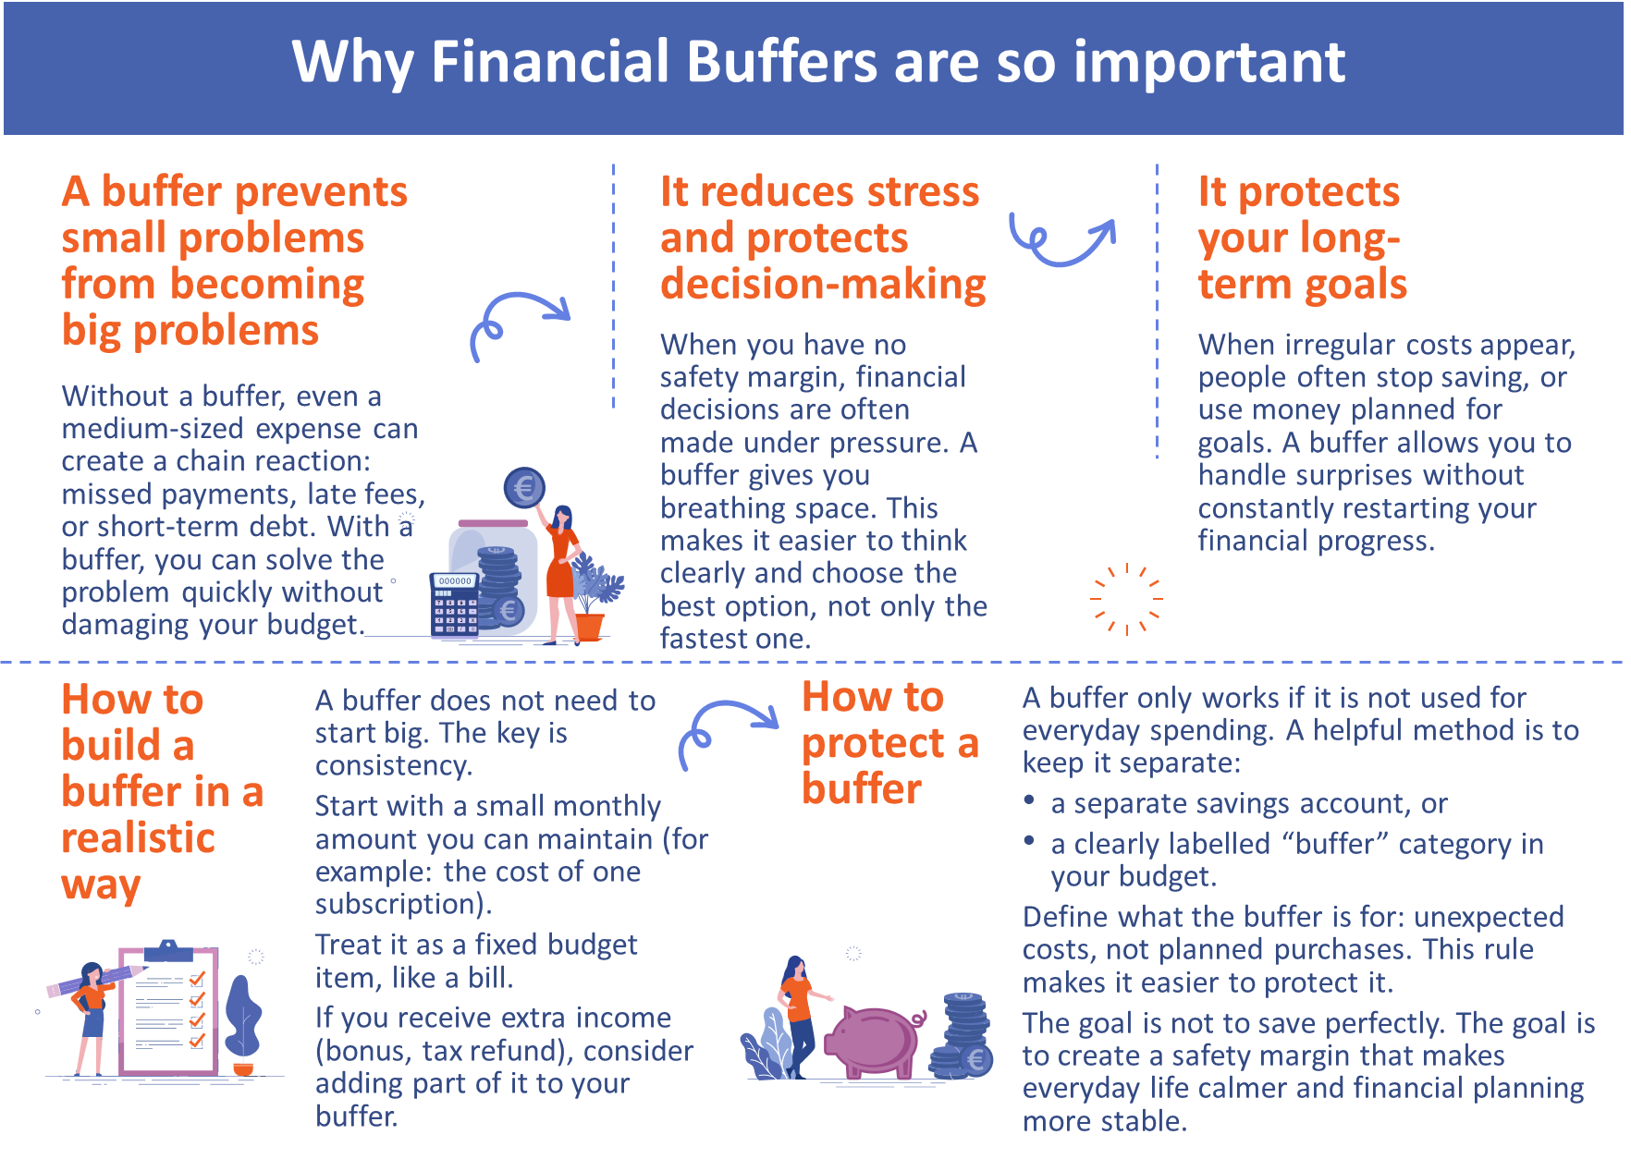
Building and protecting a financial buffer
Introduction
A financial buffer is money you set aside for unexpected costs so that you do not have to rely on overdrafts, credit cards, or loans. In mid career, a buffer is especially important because life often includes more responsibilities—and more potential “surprises”: repairs, health costs, urgent family needs, or temporary income changes.
Conclusion

Slide 26
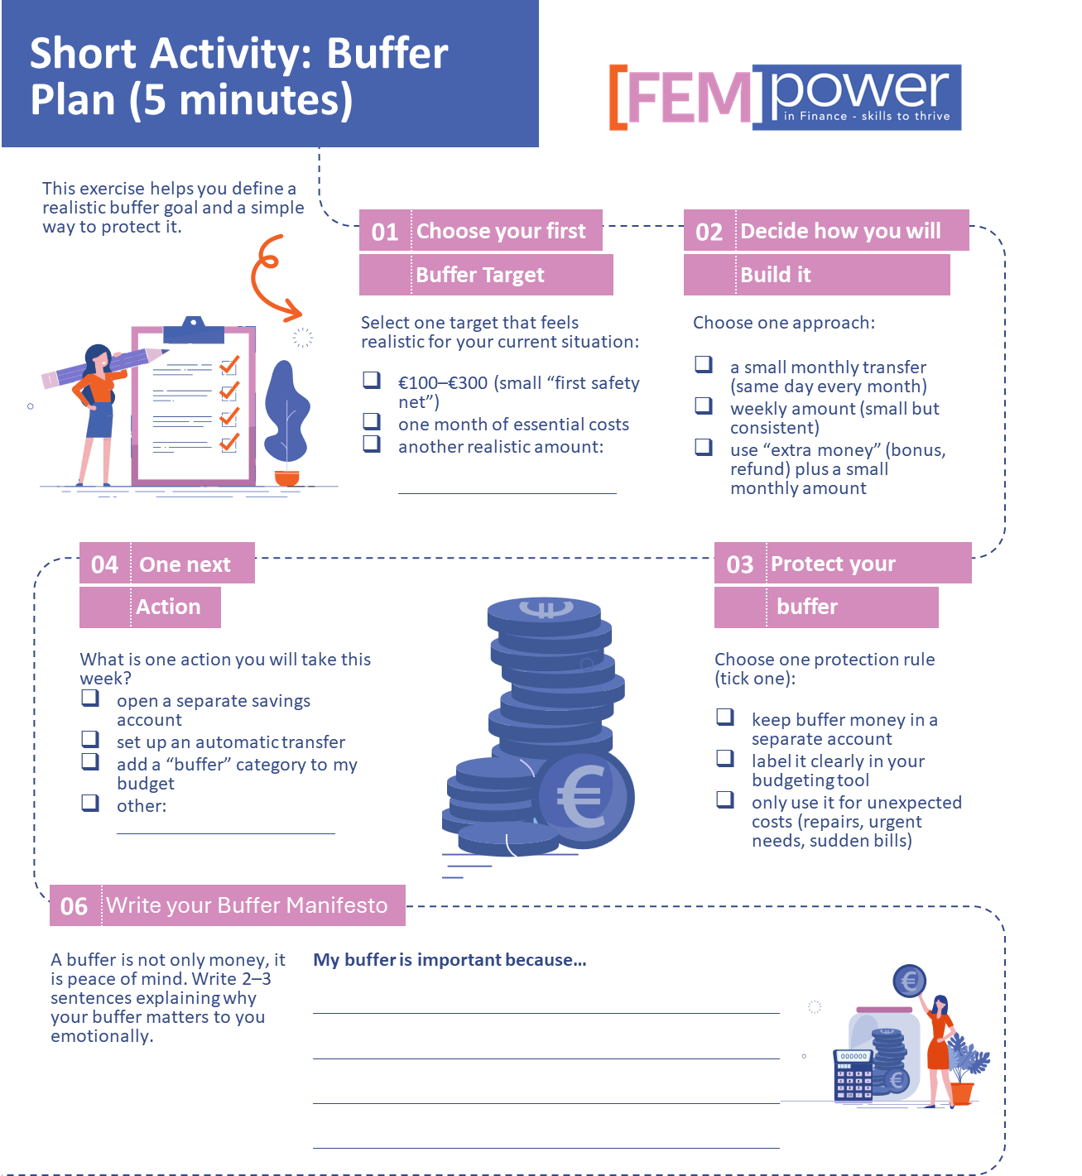
Building and protecting a financial buffer
Introduction
Conclusion

Slide 27
Your 20-minute weekly “money check”
Introduction
Activity
A Time-Saving Routine: The 20-Minute Weekly Money Check
In mid career, budgeting often fails for one reason: it requires too much time. A realistic solution is a short weekly routine that keeps you informed without becoming a burden.
A weekly money check is a planned 20-minute appointment with yourself (or your household). Its purpose is to prevent small issues from becoming stressful surprises.
How it works (20 minutes):
1) Check your account balance and upcoming payments (5 minutes)
Look at your current balance.
Check which bills or payments are due in the next 7–10 days.
Ask yourself: “Is everything covered?”
2) Review spending since last week (5 minutes)
Look at recent transactions.
Identify your top spending categories.
Notice any unusual costs (for example: higher groceries, unexpected fees).
3) Plan the next week (5 minutes)
Decide your realistic spending limits for flexible categories (food, leisure, transport).
If a larger cost is coming, plan how you will cover it (reduce something else, use the irregular-cost plan, or use buffer if it is truly unexpected).
4) One improvement action (5 minutes)
Choose one small action that makes your finances easier next week, for example:
cancel or pause one unused subscription,
set a reminder for an irregular cost,
move a small amount into your buffer,
plan groceries before shopping,
check one contract for cheaper options.
Why this routine helps
A short weekly check reduces stress because you stay informed. It supports confidence because you make decisions early, before problems grow. Most importantly, it makes budgeting simple in a busy life.
Conclusion

Slide 28
Resources
Introduction
FEMPower Tools
You can use the tools provided for this Module helping you to budget and to track your financial habits.
Resources & Further Reading
Podcasts
Financial Times – Money Clinic with Claer Barrett (real-life money dilemmas + practical steps): https://www.ft.com/money-clinic-with-claer-barrett
HerMoney – HerMoney with Jean Chatzky (financial guidance designed for women): https://open.spotify.com/show/4YAPCekRk9MiABPqmsFOn6
MoneySavingExpert – The Martin Lewis Podcast (cost-of-living, household money choices, Q&A): https://www.moneysavingexpert.com/site/listen-to--the-martin-lewis-podcast-/
Videos
The Financial Diet – How To Budget When Money Stresses You Out (15-minute format): https://www.youtube.com/watch?v=Hbnn52Bch_c
The Financial Diet – How To Budget Against Lifestyle Inflation: https://www.youtube.com/watch?v=EHDJ_Wx2ZCE
Websites & guides
MoneySavingExpert – Budget Planner (downloadable planner + guidance): https://www.moneysavingexpert.com/banking/budget-planning/
HerMoney – The Best Budgeting Tips for Your 40s and 50s (explicitly mid-life oriented): https://hermoney.com/earn/budgeting-tips-for-your-40s-and-50s/
Conclusion

Slide 29
04
BUDGETING FOR
WOMEN IN
LATE CAREER

Slide 30
Women in Late Career
Introduction
Late career and retirement can bring more financial predictability, but also new challenges. Many women move from a working income to a fixed income, such as a pension, benefits, or a combination of payments. Even when income becomes more stable, everyday budgeting remains important because costs can change, unexpected expenses can appear, and financial decisions may feel more sensitive when there is less flexibility to “earn more” quickly.
This life stage often includes costs that require careful planning, such as health-related expenses, home maintenance, mobility needs, and support for family members. At the same time, many women want to simplify their finances: fewer accounts, fewer contracts, and fewer decisions to manage each month. A good late-career budget focuses on clarity and calm: covering essentials, planning for irregular costs, and protecting a small safety margin.
Budgeting in late career is not about tracking every small expense. It is about creating a simple system that helps you feel secure. This includes practical steps such as reviewing subscriptions, organising paperwork, setting reminders for important payments, and ensuring that you have a plan for unexpected costs.
Finally, this stage of life requires attention to financial safety. Fraud and scams often target older adults. A strong budgeting routine should therefore include basic safety habits: protecting personal information, checking unusual requests, and having a clear rule for how you respond when something feels suspicious.
In this section, we will support you in building a realistic fixed-income budget, simplifying your financial life, and strengthening basic financial safety—so that you can maintain independence, confidence, and peace of mind.
Conclusion

Slide 31
Women in Late Career
Introduction
Learning Objectives
Understand how to budget on a fixed or more predictable income (salary near retirement, pension, benefits).
Identify essential costs and plan for health-related and household-related expenses.
Recognise common financial risks in late career (unexpected costs, fraud, and financial pressure).
Use simple tools and routines to simplify finances and stay in control..
Content:
Budgeting on a fixed income: clarity, prioritising essentials, and realistic planning.
Managing health-related costs and irregular expenses without stress.
Simplifying finances: reducing complexity, subscriptions, and paperwork.
Staying safe: basic fraud prevention and protecting personal financial information.
Activities:
Fixed-income budget: build a monthly plan with essential costs and a safety margin.
Simplify your finances: “reduce and organise” checklist (accounts, bills, subscriptions).
Safety check: recognise common fraud messages and create a personal protection rule.
Formative Assessment:
Scenario reflection: How would you cover an unexpected expense this month?
Checklist: Do you have a simplified system and a safety plan?
Resources:
Templates for fixed-income budgeting
Consumer protection and fraud prevention resources
Guidance on managing health-related costs and household budgeting
Simple templates for tracking
Conclusion

Slide 32
Budgeting on a fixed income
Introduction
In late career and retirement, income is often more predictable. You may receive a salary near retirement, a pension, benefits, or a combination of payments. Predictable income can make budgeting easier—but it can also feel more sensitive, because there is often less flexibility to increase income quickly if costs rise.
A fixed-income budget has one main purpose: make sure essentials are covered first and create a small safety margin.
Step 1: Start with your net monthly income
Write down what you actually receive each month after deductions. If income is paid in different parts (for example, pension + benefit), list each part clearly.
Step 2: Protect your essential costs
Essentials are the costs that keep daily life stable, such as:
housing (rent/mortgage, utilities),
basic food and household supplies,
health-related needs (medicine, appointments),
mobility (transport, car running costs),
insurance you truly need,
debt repayments (if applicable).
If essentials take up a large share of income, budgeting becomes even more important. The goal is to prevent stress by planning in advance, not by reacting at the last moment.
Step 3: Plan for irregular costs
Even on a fixed income, irregular costs still happen: repairs, medical bills, replacements (phone, glasses, appliances), gifts, seasonal spending. If these costs are not planned, they can quickly disrupt the month. A simple method is to create one monthly category called “Irregular costs” and add a realistic amount into it.
Step 4: Build a small safety margin
A safety margin is money that remains after essentials and planned irregular costs. It protects you from unexpected expenses and reduces anxiety. Even a small amount supports independence.
Step 5: Keep the system simple
A late-career budget should be easy to manage. The best budget is the one you can maintain calmly each month.
Budgeting on a fixed income is not about restriction. It is about stability, preparedness, and peace of mind.
Activity
Activity : Fixed-Income Budget (30 minutes)
Goal: Create a realistic monthly plan that covers essentials and includes a safety margin.
Start with your net monthly income (what you actually receive). Then write down your essential monthly costs: housing, utilities, food, mobility, and health-related needs. Add one monthly line for irregular costs (repairs, annual fees, replacements). Finally, set a small safety margin if possible. If the numbers do not balance, adjust variable spending first and review recurring costs.
You can use the FEMPower budget template – [ADD LINK]
Conclusion

Slide 33
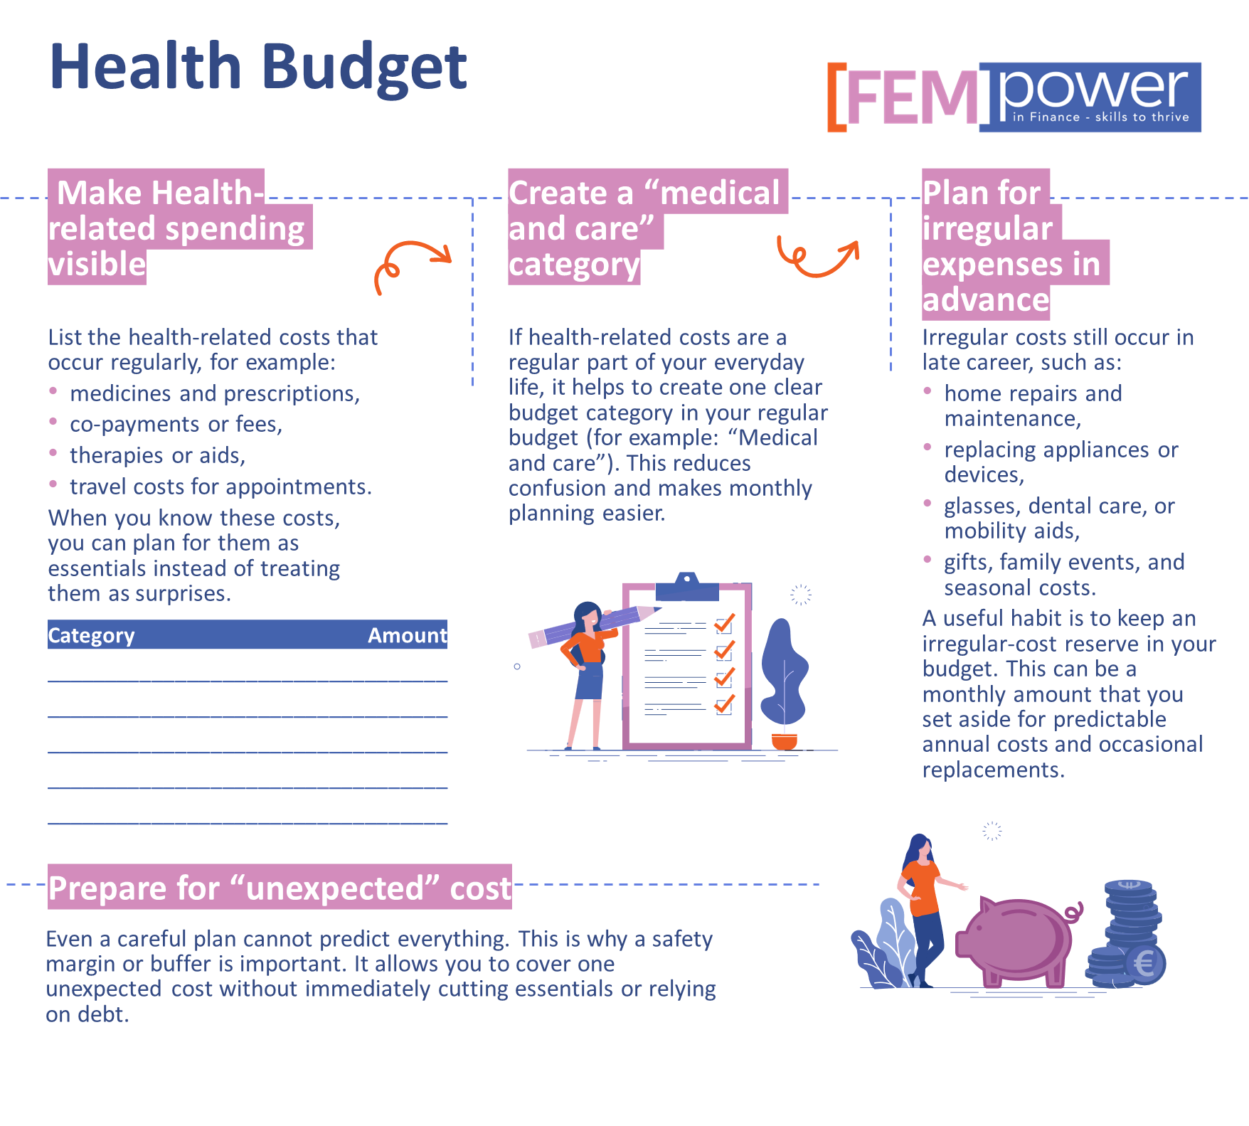
Managing health-related costs and irregular expenses
Introduction
In late career and retirement, health-related costs often become more important. These costs can be regular (for example, prescriptions) or irregular (for example, dental work or unexpected medical needs). Even when some costs are covered by insurance or public systems, many women still face co-payments, travel costs for appointments, or additional support needs.
A practical budget helps you manage these costs without stress by turning uncertainty into a plan.
Conclusion

Slide 34
Staying Safe: Fraud Prevention Basics
Introduction
Financial safety becomes especially important in late career and retirement because fraud and scams often target older adults. These scams are designed to create pressure and confusion. The goal is to make you act quickly, share personal information, or transfer money before you have time to think.
A simple safety rule is: pause first, verify second, act last. If a message or call creates urgency (“pay now”, “account blocked”, “final warning”), treat it as a warning sign. Real organisations give you time and do not pressure you into immediate action.
Common fraud methods include fake bank messages, fake delivery notifications, fake invoices, and calls from people pretending to be a trusted institution. Scammers may ask for passwords, PINs, TAN codes, or remote access to your computer. A strong rule is: never share your banking access details or security codes with anyone. Banks and public institutions will not ask for them.
Protect yourself by keeping your finances organised and simple. When you know which bills you expect and which payments are normal, suspicious requests are easier to detect. It also helps to use secure passwords, keep software updated, and avoid clicking on unknown links in emails or SMS.
If you are unsure, do not decide alone under pressure. Contact your bank or the organisation using an official phone number or website you find yourself (not the contact details in the message). If you think you have been targeted, ask for support immediately. Acting quickly can reduce damage and protect your accounts.
Financial safety is part of budgeting. It protects your money, your independence, and your peace of mind.
Activity
Activity : Fixed-Income Budget (30 minutes)
Goal: Create a realistic monthly plan that covers essentials and includes a safety margin.
Start with your net monthly income (what you actually receive). Then write down your essential monthly costs: housing, utilities, food, mobility, and health-related needs. Add one monthly line for irregular costs (repairs, annual fees, replacements). Finally, set a small safety margin if possible. If the numbers do not balance, adjust variable spending first and review recurring costs.
You can use the FEMPower budget template
Conclusion

Slide 35
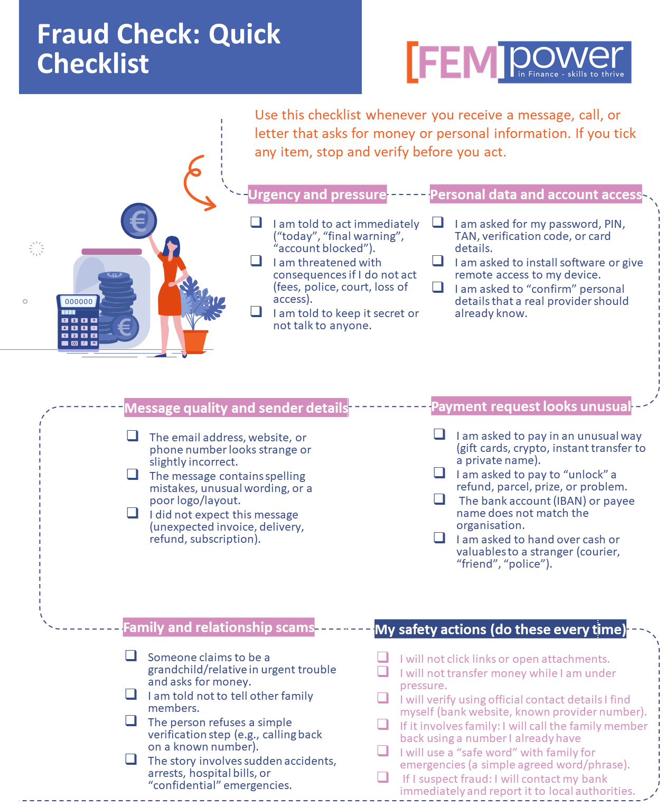
Staying Safe: Fraud Prevention Basics
Introduction
Conclusion

Slide 36
Resources
Introduction
FEMPower Tools
You can use the FEMpower in Budget Template and our Financial Habit Tracker Template
Resources & Further Reading
Websites & guides
National Council on Aging (NCOA) – Budgeting for Older Adults (step-by-step, fixed-income focused): https://www.ncoa.org/older-adults/money/management/budgeting/
NCOA – How to Budget Your Money: A Guide for Older Adults (practical guide): https://www.ncoa.org/article/how-to-budget-your-money-a-guide-for-older-adults/
AARP – Home Budget Calculator (simple overview of income vs. expenses): https://www.aarp.org/money/personal-finance/home-budget-calculator/
Videos
NCOA (YouTube) – Boost Your Budget: Find your benefits (fixed-income reality + support options): https://www.youtube.com/watch?v=9z1lnXbEvaE
BSI (YouTube) – Phishing-E-Mails enttarnen! (clear fraud recognition tips): https://www.youtube.com/watch?v=XgF42Jb8jxo
Podcasts (adult-friendly; helpful in retirement planning and daily money confidence)
Financial Times – Money Clinic with Claer Barrett (real-life money decisions): https://www.ft.com/money-clinic-with-claer-barrett
HerMoney – HerMoney with Jean Chatzky (finance for women across life stages): https://open.spotify.com/show/4YAPCekRk9MiABPqmsFOn6
Conclusion

Slide 37
05
CONCLUSION

Slide 38
Conclusion
Introduction
Budgeting and everyday financial management are not “one-time tasks”. They are practical life skills that support women through changing circumstances in early career, mid career, and late career (of course including retirement). Throughout this module, you have explored how income, costs, responsibilities, and life events shape day-to-day money decisions, and why a clear budget is one of the strongest foundations for financial confidence.
In early career, the focus is on building visibility and habits: understanding income and expenses, separating fixed, variable, and irregular costs, and creating a simple routine that prevents unpleasant surprises. In mid career, budgeting becomes a tool for managing complexity. Many costs relate to household and family needs, and time pressure can make money decisions feel heavy. Here, the aim is to create a realistic system that still works in busy weeks—planning irregular costs, protecting a buffer, and using short check-ins to stay in control. In late career and retirement, budgeting supports stability and peace of mind. A fixed-income budget prioritises essentials, plans for health-related and irregular costs, simplifies financial routines, and strengthens safety habits to reduce the risk of fraud.
Across all life stages, the key message is the same: a good budget does not restrict your life, it supports it. It helps you make choices based on clarity, protect yourself from financial shocks, and reduce stress by preparing rather than reacting. Even small improvements—reviewing subscriptions, planning irregular costs, creating a buffer, or doing a short weekly check—can make a meaningful difference over time.
As you complete this module, keep using the templates, checklists, and activities provided. Return to your budget whenever life changes, and adjust it without judgement. If you need support, seek neutral advice early rather than waiting until stress grows. Every step you take strengthens your financial resilience and supports greater independence and confidence—today and in the future.
Conclusion

Slide 39
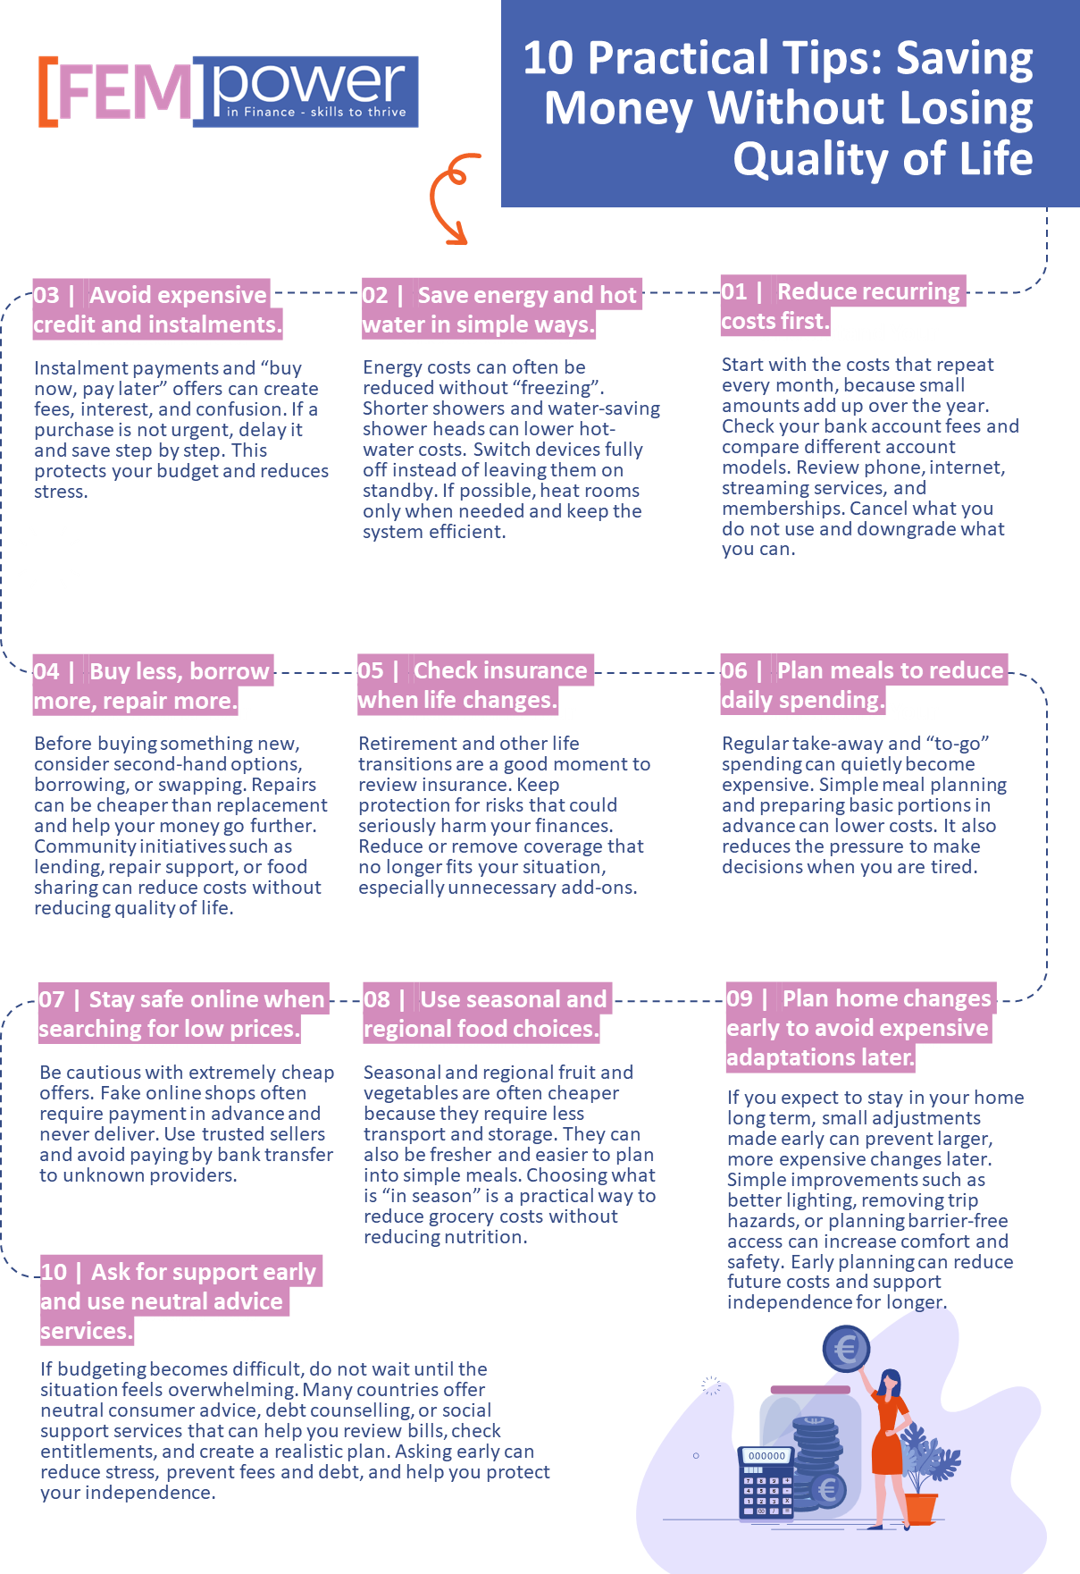
Final tips
Introduction
Conclusion

Slide 40


Website Here
Follow Our Journey
www.fempower.finance

